Slide 1
Checking the Isis flag status
A complete guide to checking Iffley lock
JE, VL, last revised KSU, QS: MT22

Slide 2
What does the flag mean?

Slide 3
Flag colours:
Green
No restrictions on coxing status.
Novices coxes must be accompanied by a bankrider.
Light blue
No unregistered coxes.
No novice coxes.¹
Spinning rules.²
Crews may not go above Folly Bridge or through Iffley Lock.
Dark blue
No unregistered coxes.
No novice coxes.
Spinning rules.²
Crews may not go above Folly Bridge or through Iffley Lock.
Amber
Only senior coxes with senior crews³.
Bank rider equipped with throw-line and a pre-programmed mobile phone.⁴
Spinning rules.²
Crews may not go above Folly Bridge or through Iffley Lock.
Red
No rowing ☹
1. N-status coxes with more than one term’s experience allowed with senior crews³ in daylight hours only.
2. No spinning at Longbridges, except to immediately land (at LB). At Haystacks, spin upstream of the red-and-white post and downstream of the early turning post near Donnington Bridge.
3. At least 4 rowers with 3 terms' experience, no rowers with less than one term
4. With number of the Iffley Lock-keeper (01865 777 277)

Slide 4
How the flag colour is determined:
OURCs sets the flag colour based on the conditions on the river, taking into account how fast the stream is flowing, wind etc.
2.8.g.vii "The flag may be changed when considered necessary by the OURCs committee for reasons other than the stream at Iffley Weirs. […]”.
The flag colour may not be ‘calculated’ directly by checking the lock; get in touch with the OURCs Secretary or Sabbatical Officer with any questions
The rate of flow is measured in bucks, which, on the Isis, is a certain amount of water flowing through Iffley lock:
0 – 1 ¾ bucks
2 – 2 ¾ bucks
3 – 3 ¾ bucks
4 – 4 ¾ bucks
5 bucks or more

Slide 5
A helpful flag guide:
Bucks | Basic Flag Levels | Exceptions
0 - 1¾ | Green Flag: N coxes need a bankrider. | Unregistered coxes allowed during vacations and before first coxing registration meeting of each term.
2 - 2¾ | Blue flags: X and S coxes only, no spinning at Longbridges, spin downstream between Turn Early Post and Haystacks. | N-status coxes with more than one term’s experience allowed with senior crews in daylight hours only.*
3 - 3¾ |  | Dark Blue Flag: no exceptions
4 - 4¾ | Amber Flag: S-status coxes with senior crews only. All crews must be accompanied by a bankrider.* | At Godstow, X-status coxes are allowed. Also at Godstow, all crews must be accompanied by a launch.
>5 | Red Flag: No crews allowed out. | Depending on conditions, OURCs may run races on Red Flag, due to the other safety precautions in place (medical launches, marshals, etc).
NOTE: The full set of requirements for outings under different flags is given in the Code of Conduct sections 2.8.g (Isis) and 2.9.c (Godstow). Outings with a *: bankrider must have a throw-line and the number of the lockkeeper (01865 777 277) on their phones.

Slide 6
How to check Iffley lock
A step-by-step pictorial guide

Slide 7
Where is Iffley lock and how do I get there?
Folly Bridge
1.
Boathouse Island
Longbridges
2.
3.
4.
Haystacks
5.
6.
Here!
7.
8.

Slide 8
1. Walk down the towpath.

Slide 9
2. Cross towards the lock.

Slide 10
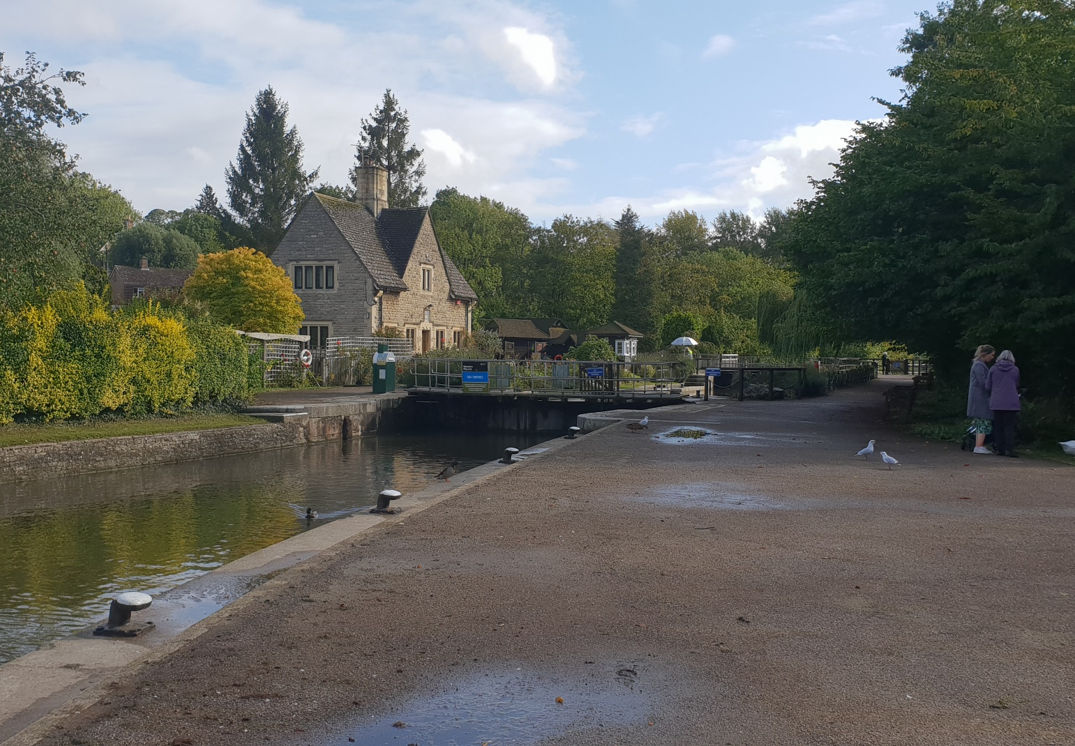
3. Walk towards the lock.

Slide 11
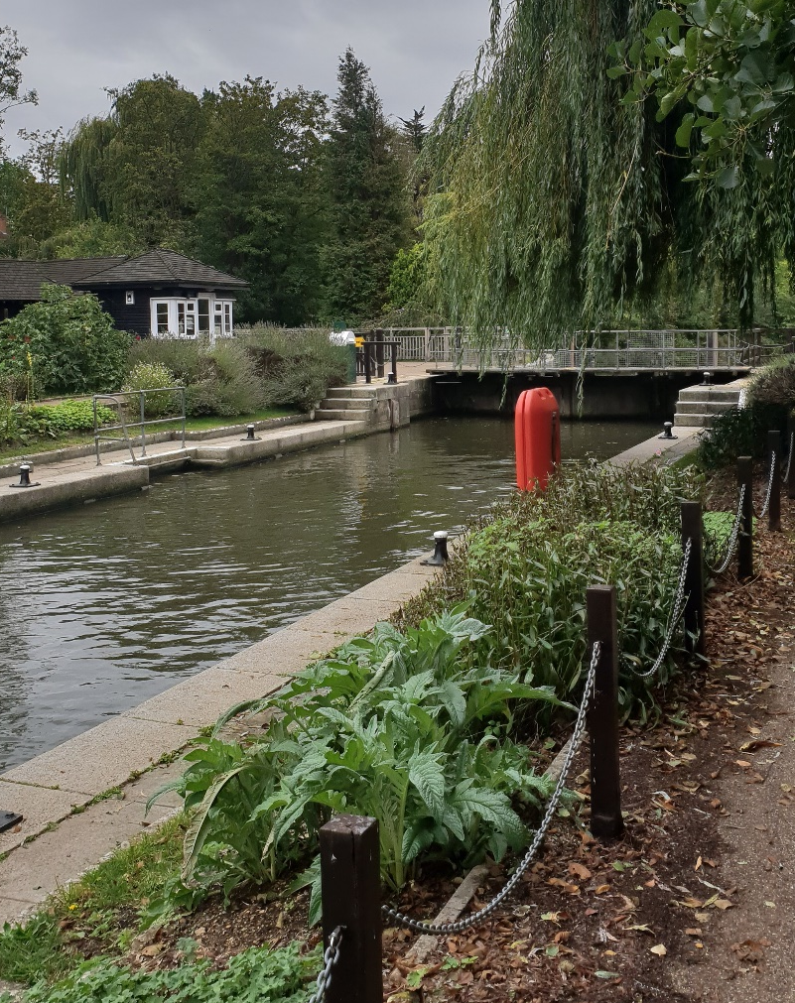
4. Walk past the lock.

Slide 12
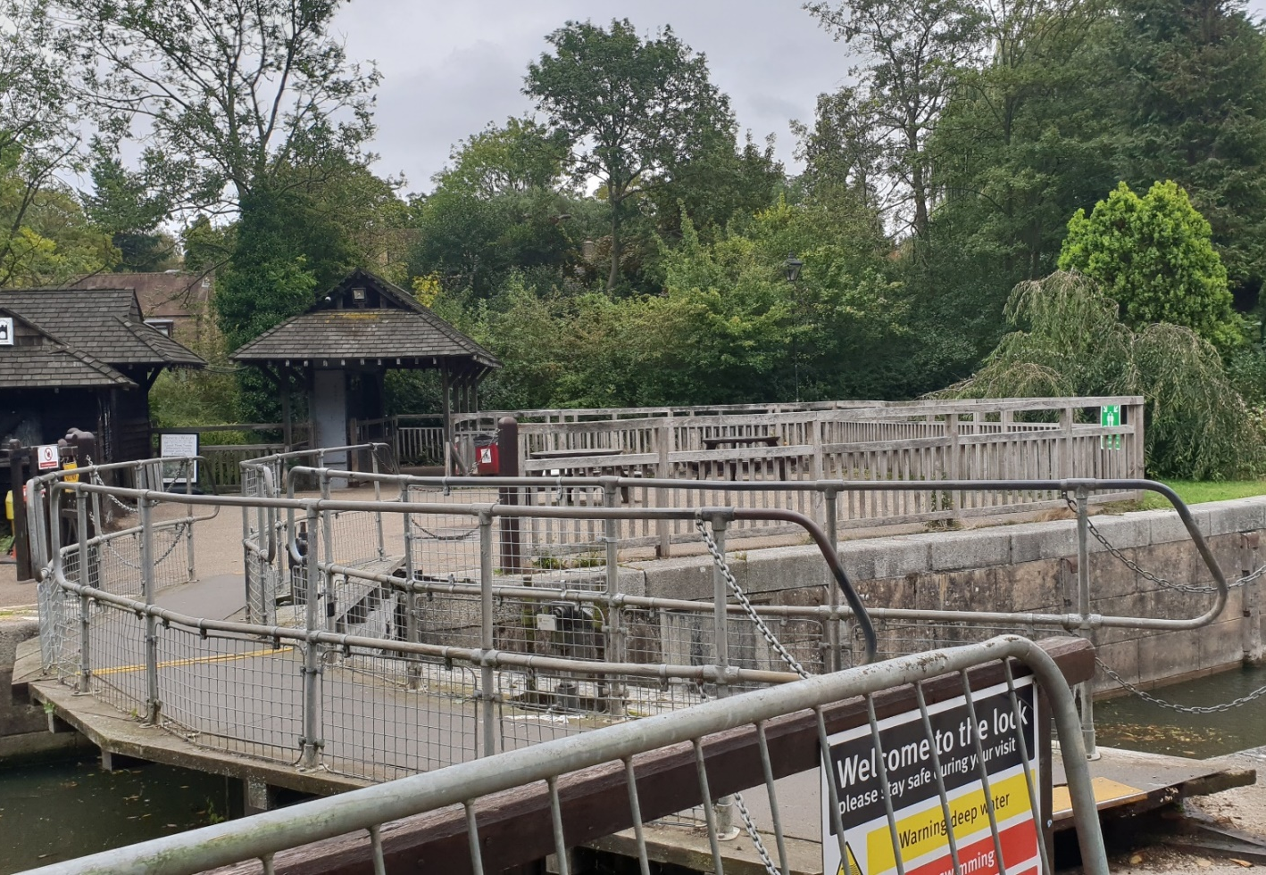
5. Cross the bridge.
(That’s Stoney!)

Slide 13
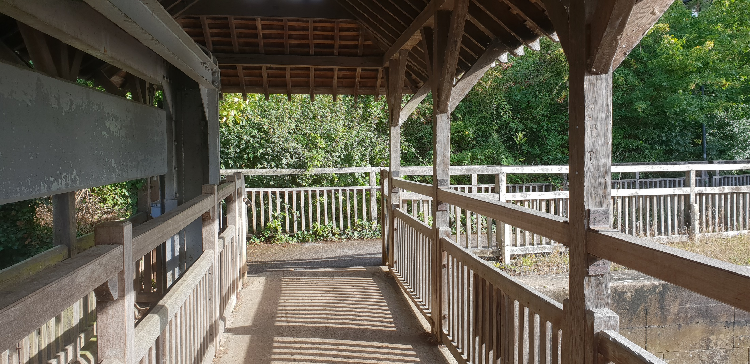
6. Check Stoney
Then continue and walk through.
(Stoney!)

Slide 14
What is Stoney?
This!
Stoney is a massive stone counterweight for a big weir.

Slide 15
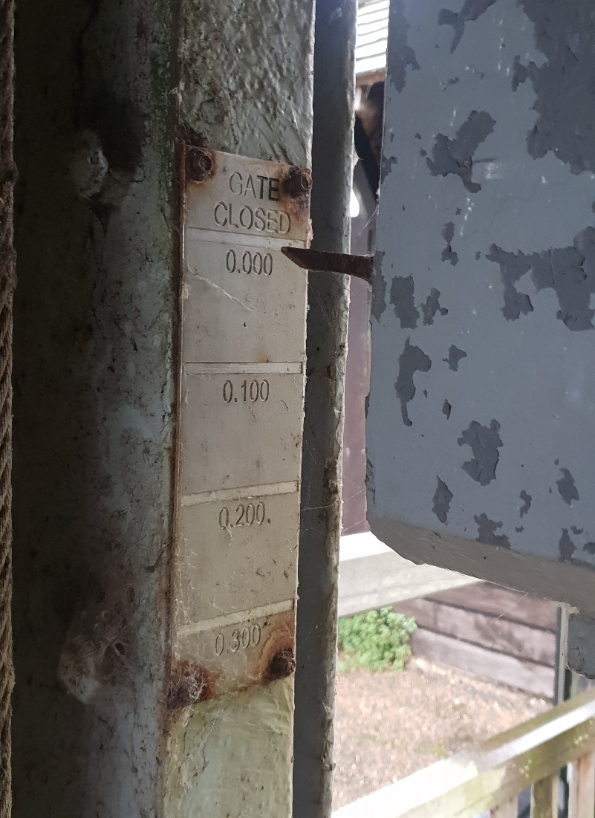
How to check Stoney:
On the left hand end of Stoney, there is a pointer and some lines.
Closed
0 bucks

Slide 16
How to check Stoney:
Each line is 3 inches, which is ¼ of a buck.
6 inches
½ a buck

Slide 17
How to check Stoney:
Stoney is usually only opened to a maximum of 15 inches.
12 inches
1 buck

Slide 18
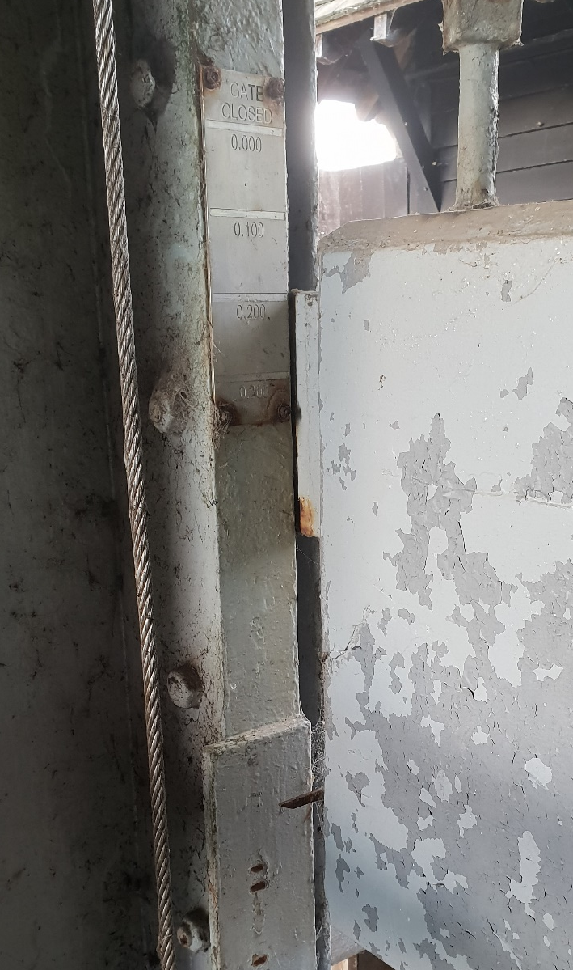
How to check Stoney:
On red boards at Iffley lock, it sometimes opens more.
Like, 2 feet!?
2 bucks

Slide 19
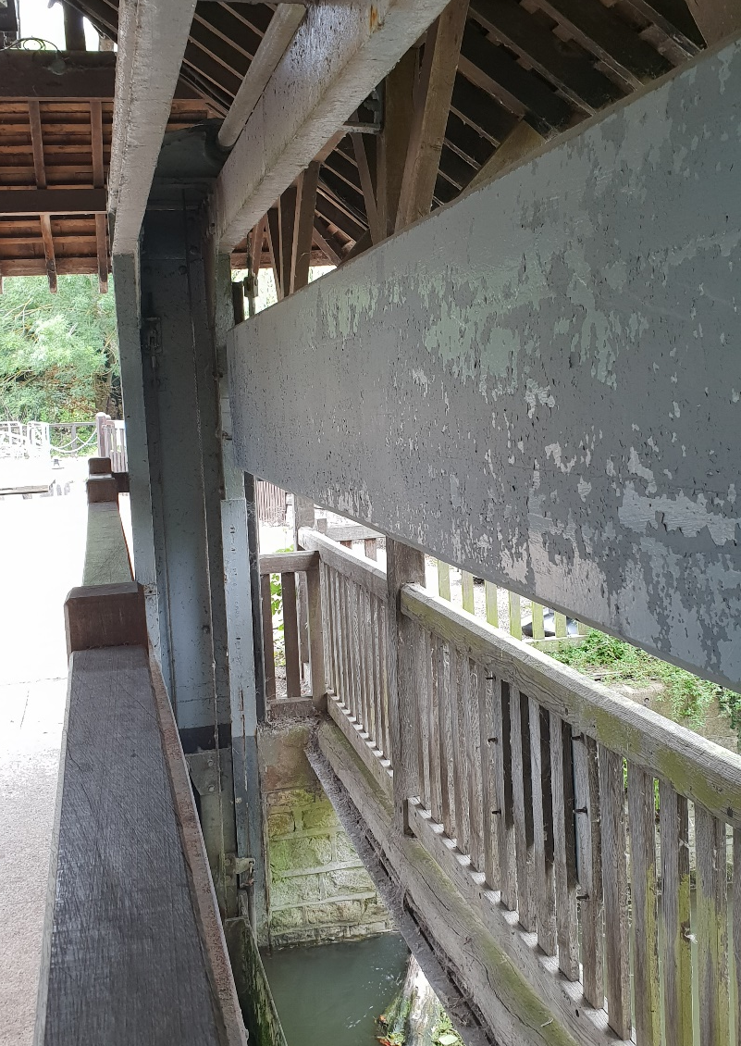
How to check Stoney:
Stand at the right hand end of Stoney and look along it to see clearly which line the arrow is pointing at.
Take a note and/or a photo! Then continue the journey…

Slide 20
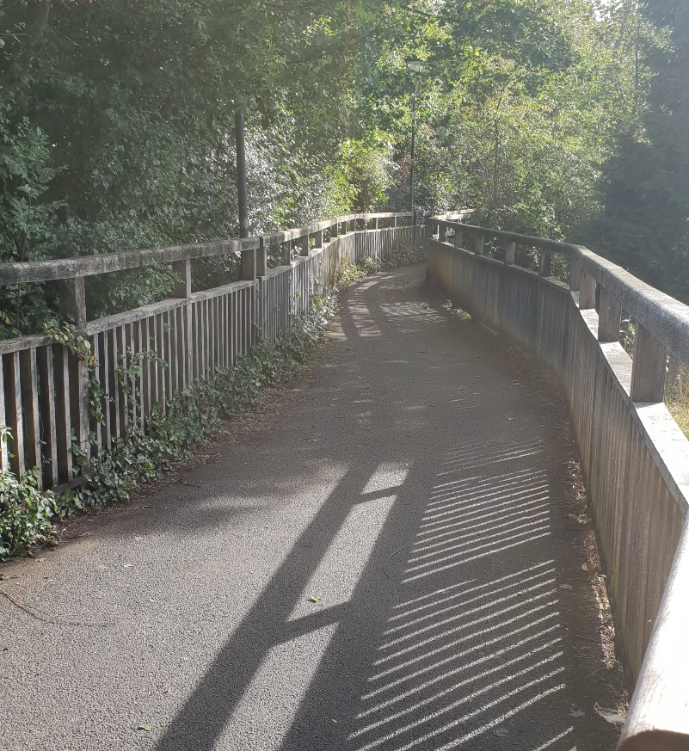
7. Walk down the path.

Slide 21
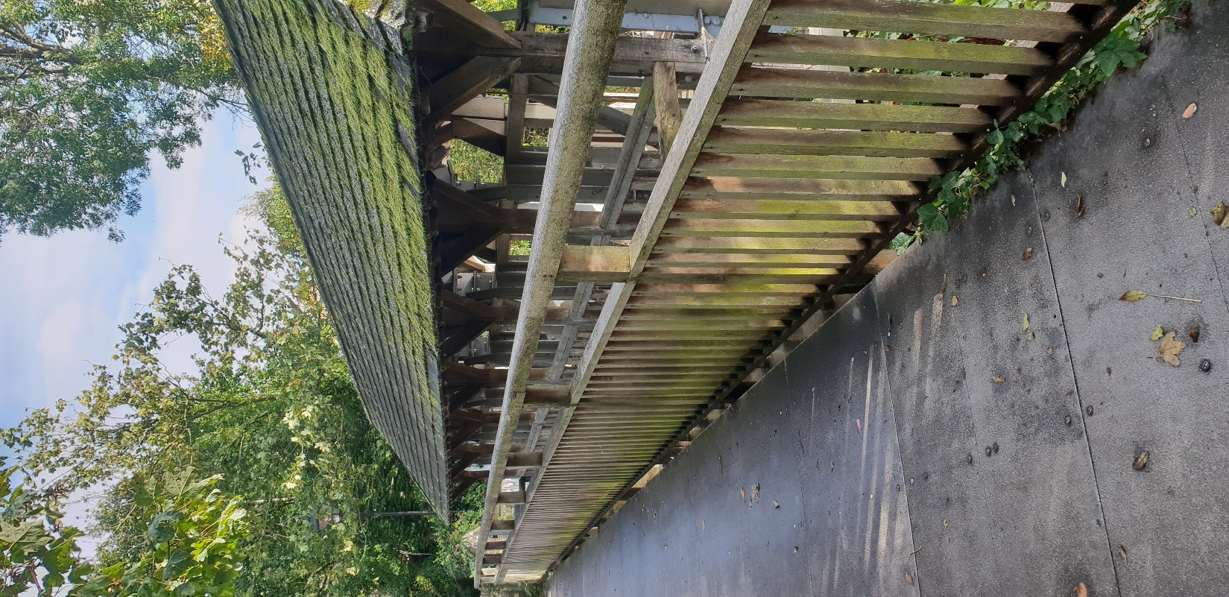
8. Check the gates & sticks.
(Sticks)
(Gates)

Slide 22
How to check the gates:
There are six big gates, each of which is worth 1 buck when open.
Note the number of open gates down as well and/or take a photo.

Slide 23
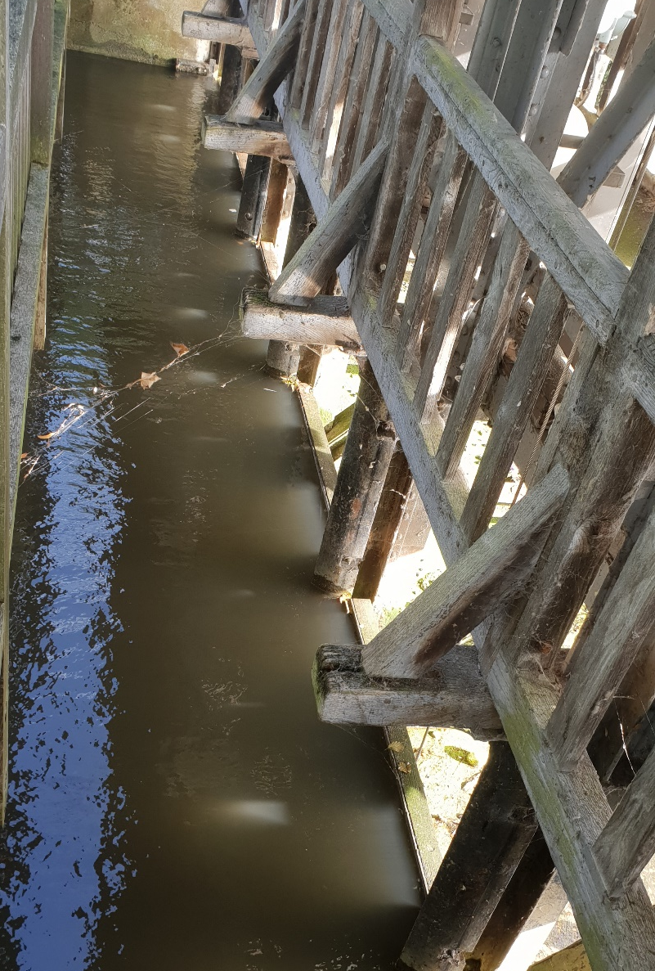
How to check the gates:
If the gates are closed, even if water is flowing over the top of them, it is 0 bucks.

Slide 24
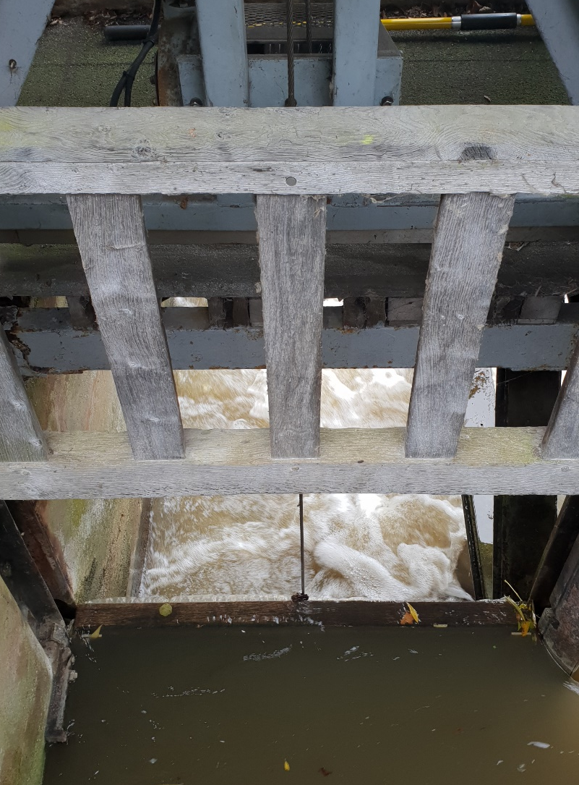
How to check the gates:
This gate is closed. The big shutter bit is all the way down.
0 bucks

Slide 25
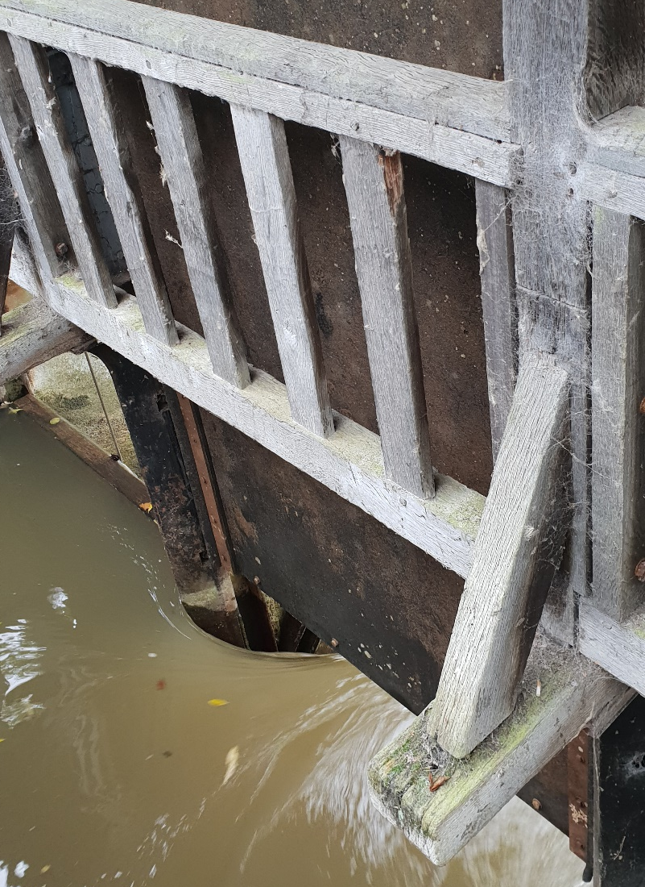
How to check the gates:
This gate is open. The big shutter bit is all the way up and is clear of the water.
1 buck

Slide 26
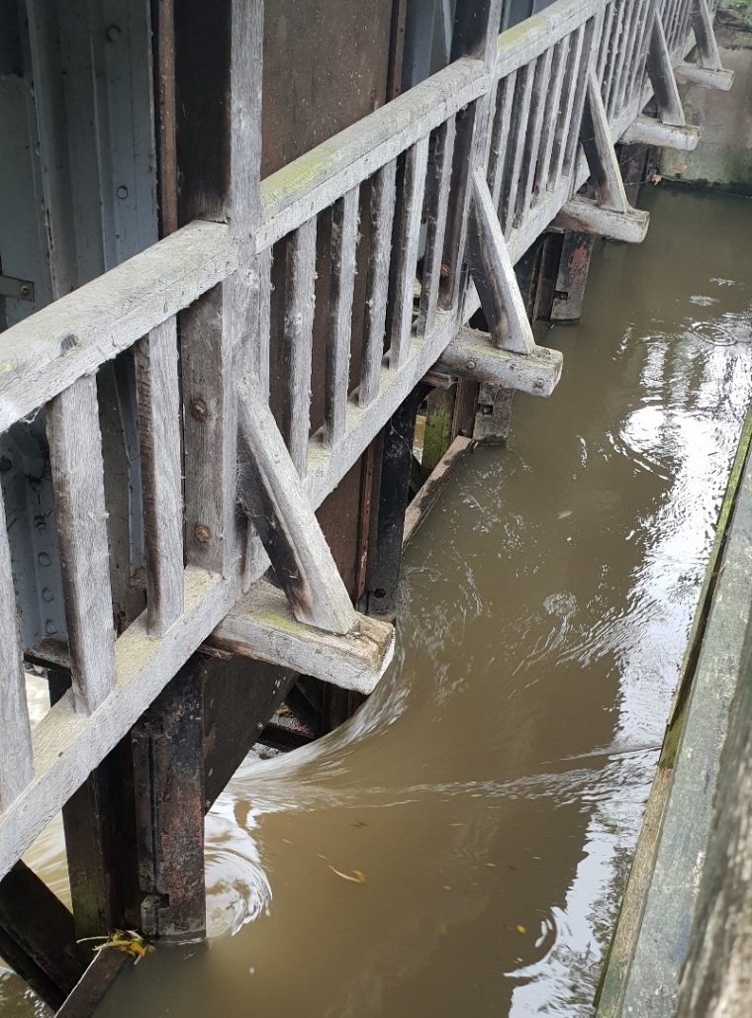
How to check the gates:
There is one gate open here. It is as far up as it can go.
1 buck

Slide 27
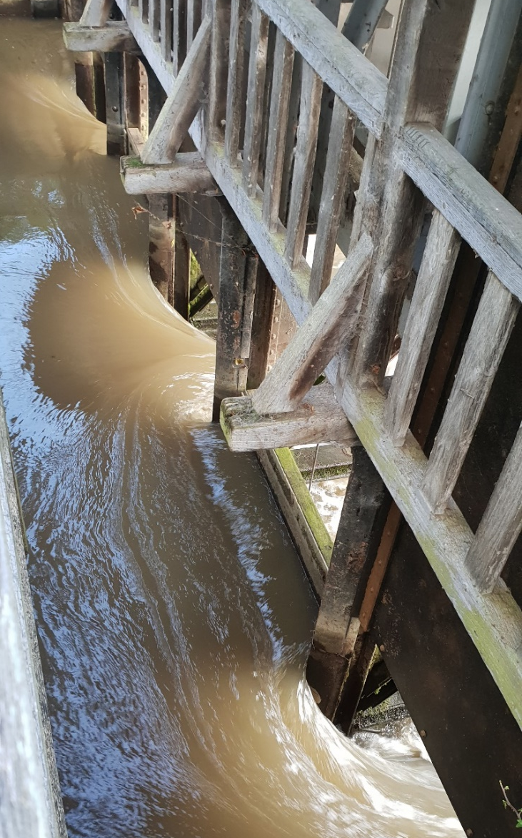
How to check the gates:
There are 3 gates open here. Add them up.
3 bucks
1 + 1 + 1 = 3

Slide 28
How to check the sticks:
Walk past the big gates to the sticks.

Slide 29
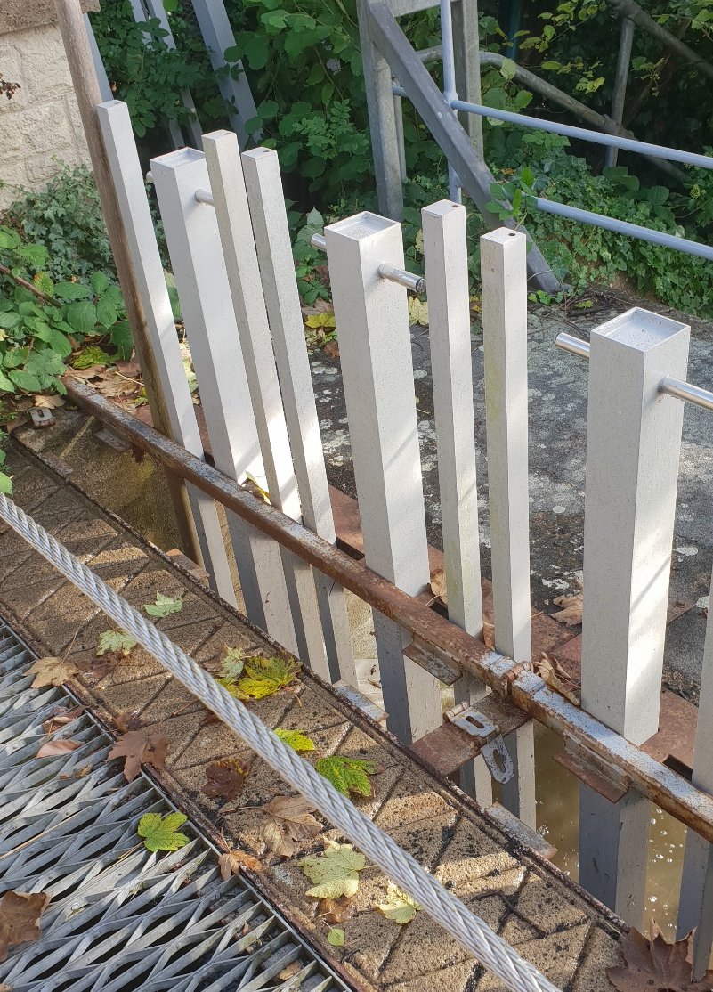
How to check the sticks:
If the sticks are there, it is 0 bucks (even if not all of the sticks are there).

Slide 30
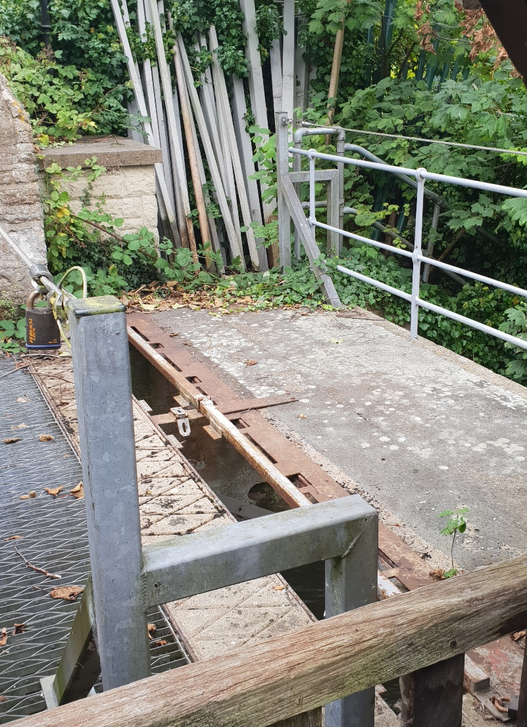
How to check the sticks:
If all the sticks are out, it is ½ a buck.
Sticks are removed from here…
… and dumped on the bank here.

Slide 31
Maths time!
Add up the contribution from Stoney, gates, and sticks
That’s the number of bucks!
Stoney + gates + sticks = bucks
For example:
3 inches on Stoney (1/4 buck) , 0 gates, sticks out (1/2 buck) = ¾ of a buck
9 inches on Stoney (3/4 buck) , 3 gates open (3 bucks) , sticks out (1/2 buck) = 4 ¼ bucks
Remember:
1 line on Stoney = 3 inches = ¼ buck
1 gate open = 1 buck
Sticks out = ½ buck
Although the lock may say the stream is flowing at a lower rate than the current flag (e.g. 2¾ of a buck but on Dark Blue flag), the flag is determined by OURCs on overall conditions (stream, wind etc.), so may be higher.

Slide 32
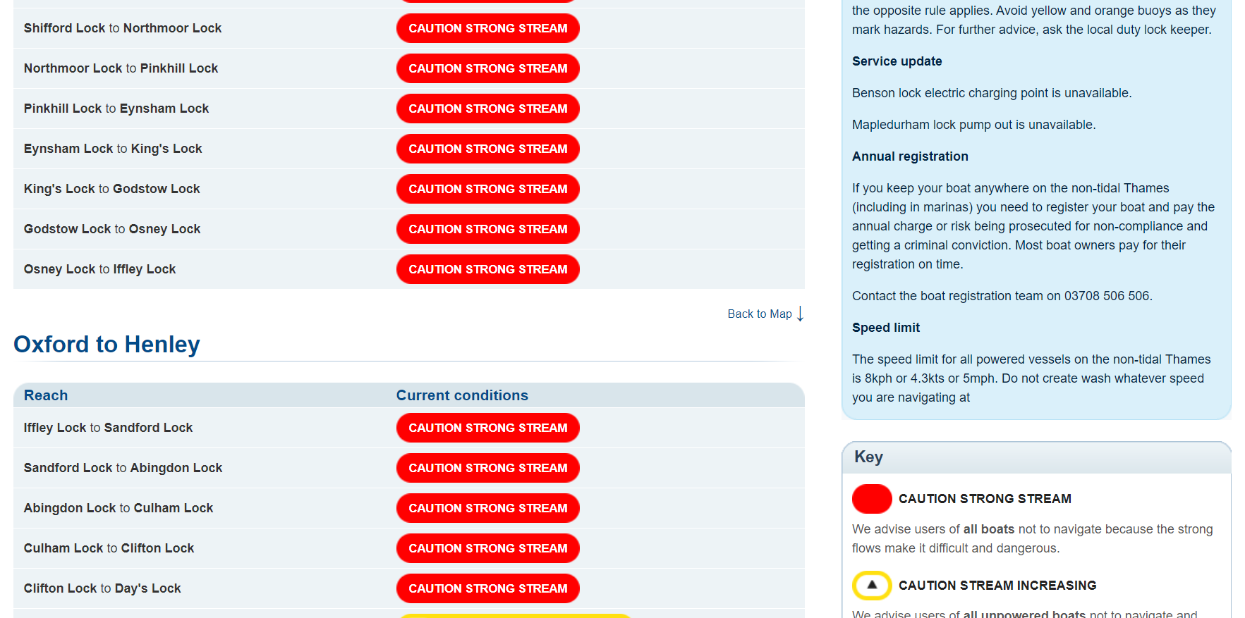
Appendix 1 – boards at the locks:
Just check the website.

Slide 33
If you don’t trust technology and/or the apocalypse happened and the internet no longer works…

Slide 34
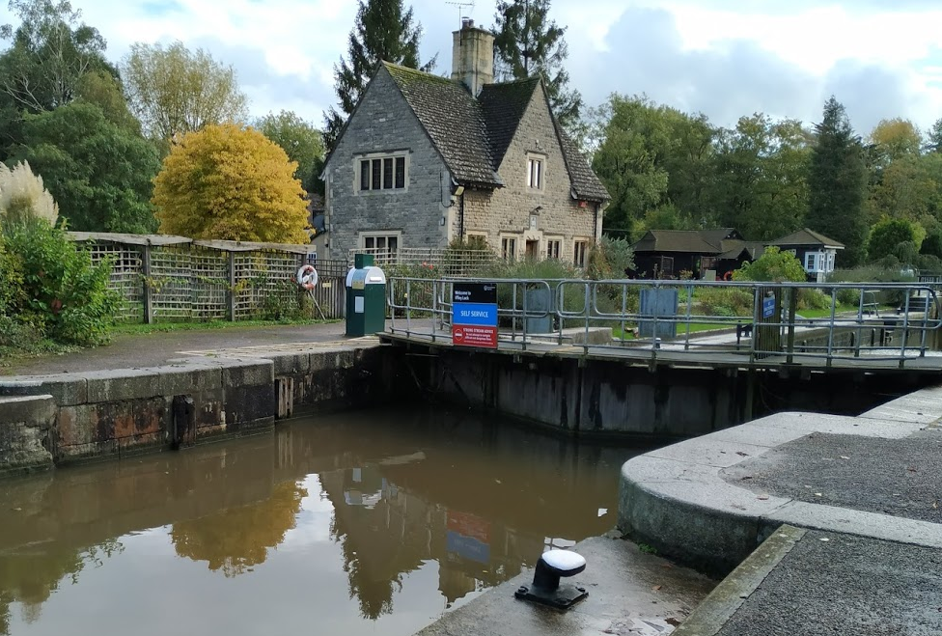
Iffley upstream

Slide 35
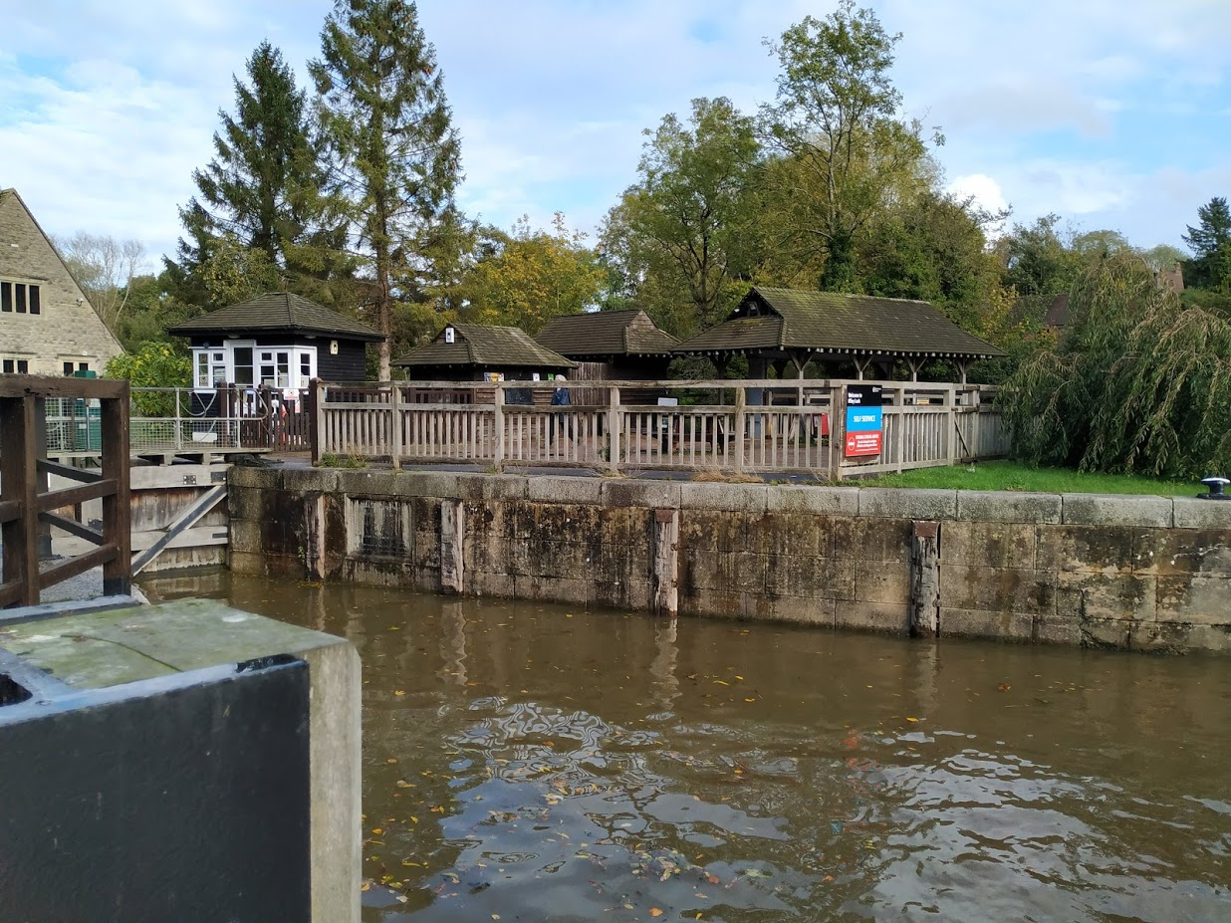
Iffley downstream

Slide 36
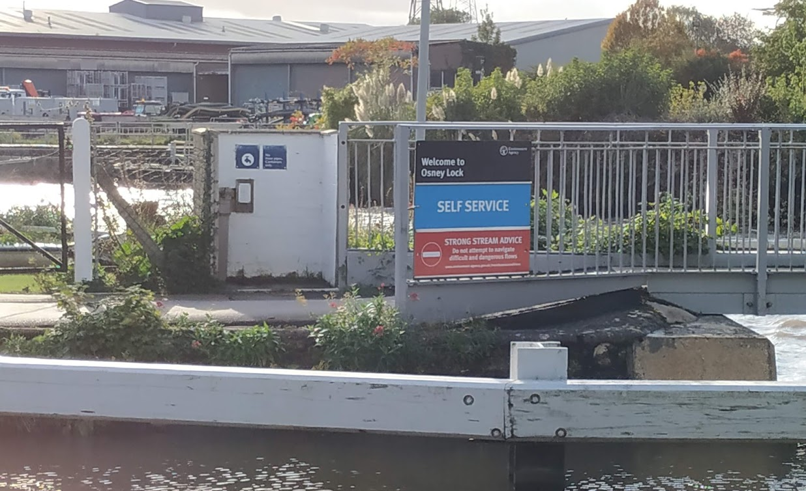
Osney upstream

Slide 37
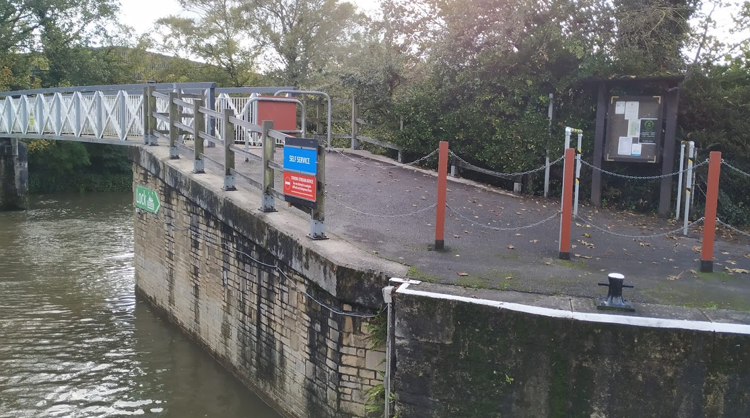
Osney downstream

