Slide 1
Bankrider briefing and bumps rules for coaches
Bumps 2024 – Rachel Quarrell

Slide 2
What’s in this briefing
Introduction and why the briefing is needed
Legal situation and liability
What to do while riding (training and racing)
For coaches, the Rules of Racing
New: what to do if involved in a towpath accident.

Slide 3
Introduction

Slide 4
Why the bank rider briefing is needed
The University of Oxford’s duty of care
Expectations of student-organised training and events
OU Sports Safety hierarchy

Slide 5
What happens if it goes wrong
Things to do
Important bumps safety rules

Slide 6
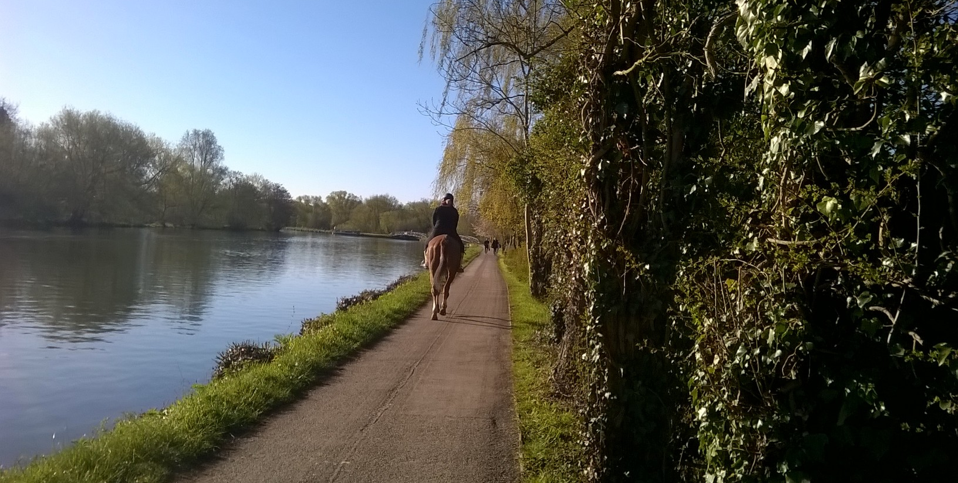
The towpath in Oxford is a bridleway

Slide 7
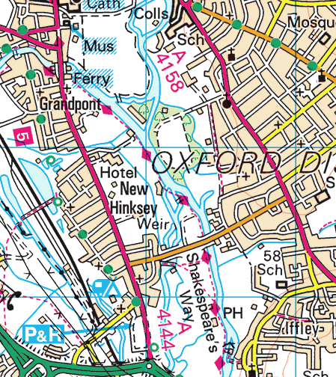


The towpath is a bridleway
Access is controlled by the Countryside Act
It is also part of the Thames Path, which has no special legal status as a highway

Slide 8
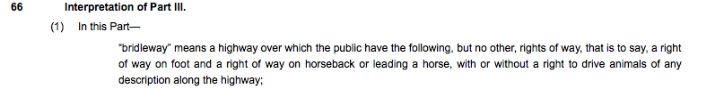
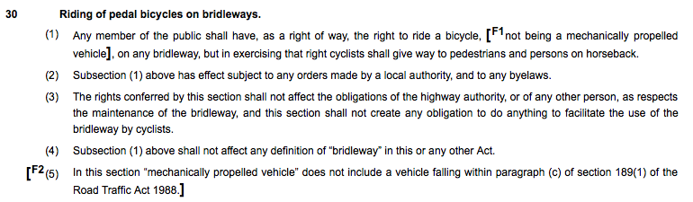
The Countryside Act

Slide 9
What does this mean?
Cyclists are guests on the towpath…..
Give way to pedestrians
This includes people temporarily pedestrian (ie standing beside cycles)
And people who dash out into the path of cyclists unexpectedly
No right of passage through (includes commuter cyclists)
There are no formal rules about which side of the bridleway a cyclist should ride since it is a path not a road
Highway rules on lights DO apply (and bad brakes or a poorly-maintained bike would be indefensible if in an accident)
No ‘two tings’ rule (but bells are strongly advised)

Slide 10
What if you were in an accident?
You would want to be able to demonstrate in court that you understood the legal rights of pedestrians and cyclists on the towpath and cycled aware of them;
And that you had paid great care and attention while cycling (ie had taken all steps possible to avoid an accident).
You need to avoid being accused of any contributory negligence….
You could be personally liable for having injuries or death caused in any way by your bike or your actions while riding it.
Insurance options?
British Rowing
CycleGuard
Wiggle
British Cycling

Slide 11
What do you need to do – when you’re riding (training)
Keep a very sharp lookout (even if accompanying a crew)
Give way to pedestrians
Be considerate
We advise you have a bell on your bike and use it – but do not be aggressive
You are expected to use lights when necessary
Cycle competently! No hand-held videoing while cycling….
Be particularly careful when cycling fast with crews doing pieces
ALWAYS remember that other towpath users have as much right to be there as you, however unpredictable, drunk or vulnerable.

Slide 12
Equipment
* You are very strongly advised to have a bell on your bike if possible
* Your bike should have lights on if the visibility is poor (dim light or mist)
* During racing you are required to wear a bankrider bib which can be signed out from racedesk and must be returned straight after the division. All bankriders must have been briefed since 1st January 2023 either here or in a riverside briefing on race day. Unless rules change this briefing will last for 18 months.
* All cyclists are strongly advised to have both hands on the handlebars at all times. Carrying and filming from a camera or phone is not allowed during racing, and very risky during training.

Slide 13
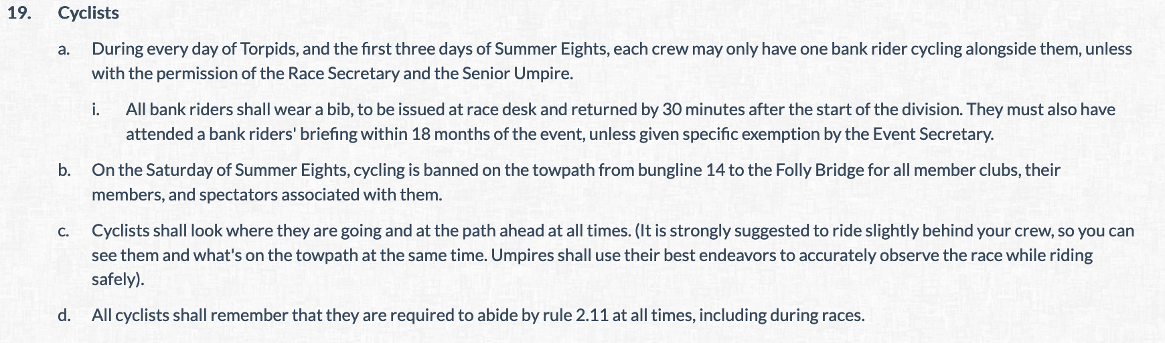
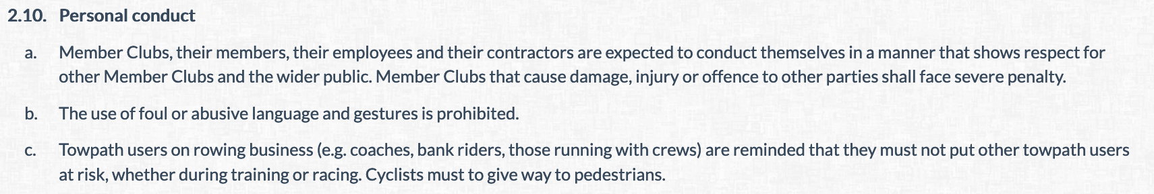
OURCs rules for cyclists bankriding during bumps
From the Rules of Racing (A3.19)
From the Code of Conduct (A2.11)

Slide 14
What do you need to do – when you’re riding (during races)
Keep a very careful lookout
Give way to pedestrians
Be considerate, and be ready to stop suddenly if necessary
We advise you have a bell on your bike and use it – but do not be aggressive (and please don’t use klaxon-like horns during OURCs races….!)
Don’t film while cycling unless you can do so with both hands on the handlebars and while keeping a good lookout
Cycle competently! You will be responsible for any accident you cause
We won’t stop races for towpath blockages so you need to be aware it may go ahead without you.

Slide 15
What do you need to do – admin
Turn up in time to get and sign for a bib – you cannot just grab it
– BRING PHOTO ID
Make sure anyone who is not here is planning to go to one of the (small number) of on the day briefings – these are at pre-set times (11:45 each day)
Be certain a briefed coach can ride if you have a novice cox – missing a briefing does not exempt you from this rule – novice coxes may be withdrawn
Return your bib immediately post racing
Personal conduct fines can still be applied

Slide 16
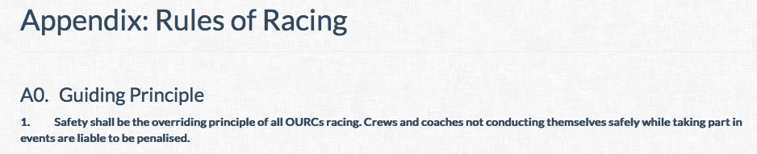
The current safety rules for crews (1)
RULE ZERO

Slide 17
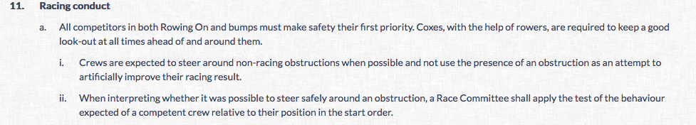
The current safety rules for crews (2)
CREWS SHOULD BE COMPETENT ENOUGH TO RACE SAFELY
Make sure your stern pair know how to help your cox

Slide 18
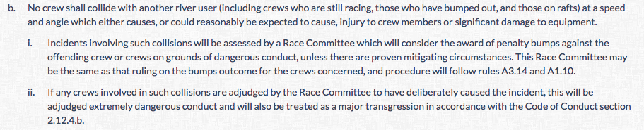
The current safety rules for crews (3)
DON’T CRASH INTO OTHERS DANGEROUSLY

Slide 19
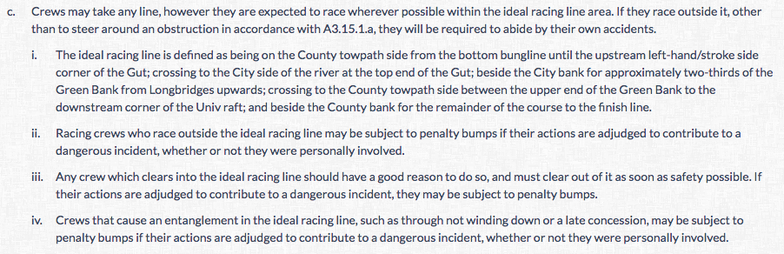
The current safety rules for crews (4)
THERE IS A RACING LINE.
CREWS SHOULD TRY TO AVOID RACING OUTSIDE IT UNLESS
ABSOLUTELY NECESSARY.
CREWS MUST AVOID CLEARING INTO IT, AND NOT STAY THERE.

Slide 20
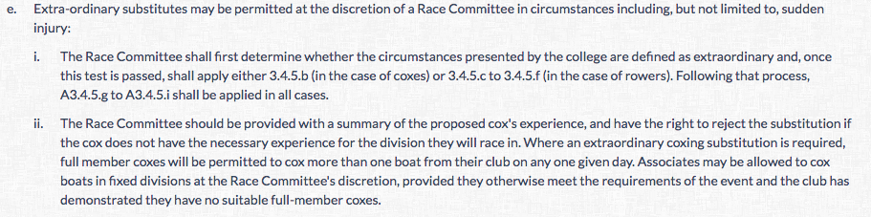
The current safety rules for crews (5)
EXTRAORDINARY SUBS RULES HAVE BEEN TWEAKED
(and then the sub-sections about rowers are still there)

Slide 21
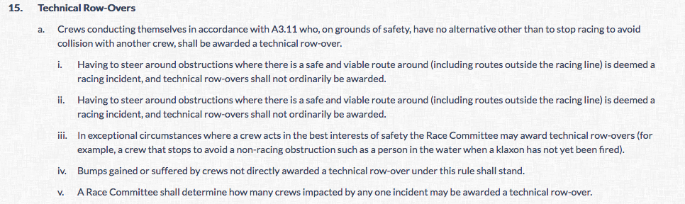
The current safety rules for crews (6)
THERE IS NO ‘UNAVOIDABLE EXTERNAL INFLUENCES’ RULE NOW
(the rest of the technical row-overs rule is still the same)

Slide 22
New 2023 — after towpath incidents
The OU Sports Safety Officer, in order to reduce the risk of towpath accidents, has required OURCs to make changes to what should happen after a towpath incident.
The new plan is different depending on whether a crew is racing at the time or circulating before or after a race, and whether the cox is novice or X/S.

Slide 23
After towpath incidents part b)
Towpath incidents during racing
Any bank rider involved in an incident (accident) on the towpath must stop and ensure all parties involved in said incident are uninjured or must remain with any injured parties until further assistance arrives.
Before returning to their racing crew, the bank rider must also exchange information with any parties involved in the incident if appropriate.
If either of these actions leads to the bank rider being absent from a racing crew with an N-status cox for any period of time, the bank rider must notify the nearest marshal, who shall notify Race desk to ensure the crew is adequately supported until the bank rider can return to their crew. This may include holding the crew at the finish until the bank rider can return and ‘collect’ their crew. (During racing N coxes are supported by the following launch).

Slide 24
After towpath incidents part c)
Towpath incidents before or after racing on a race day
Any bank rider involved in an incident before or after racing must stop, as must their crew.
The bank rider must alert the nearest marshal and proceed as on the previous slide, with Race desk expediting substitute bank riders if the crew is yet to race.

Slide 25
Conclusions
Questions

