Slide 1
Torpids 2023: How to be a Marshal and an Umpire Presentation for colleges

Slide 2
Contents
Section | Slide number | Skip to
Introduction and objectives | 2 | >>
The circulation pattern | 8 | >>
Marshalling information | 16 | >>
“When things go wrong” | 31 | >>
Towpath marshalling | 52 | >>
Umpiring information | 64 | >>
Review of objectives | 73 | >>
RQ’s Bumps problems | 74 | >>
Useful links | 78 | >>
What you need for this presentation:
Speakers
An internet connection to launch YouTube videos

Slide 3
Objectives What you should know by the end of the presentation
All people attending this briefing should:
Know how bumps racing works
Know the circulation pattern before, during, and after racing
Know when and where to report for duty
Additionally:
Marshals only | Umpires only
4. Be able to identify river traffic | 4. Know how to follow a race
5. Understand how and when to klaxon | 5. How to report the outcome of a race
6. Understand how to summon First Aid
On the day, we will provide a 15 minute ‘refresher’ of the key duties, but this cannot cover all of this material so please learn it now!

Slide 4
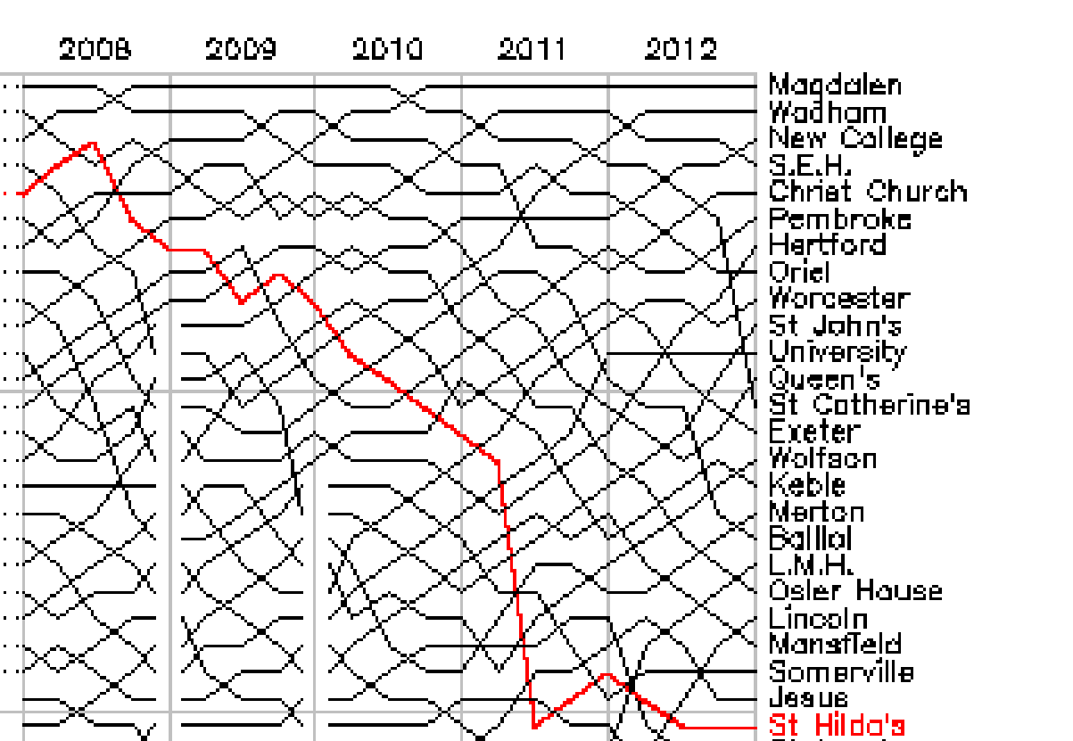
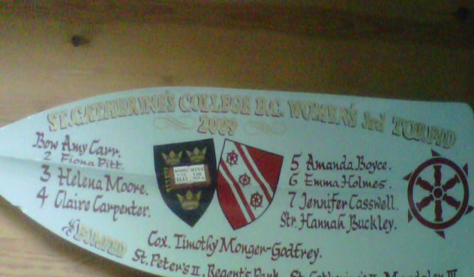
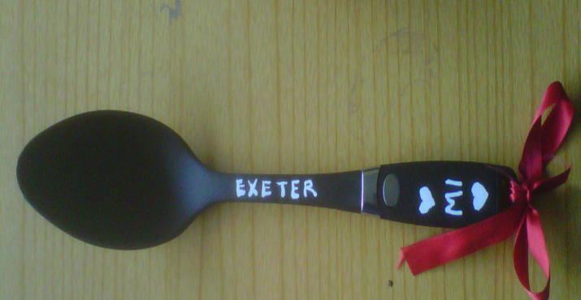
Introduction to Bumps racing What is it all about?
Video: An example of the race starting
Thirteen boats line up single-file, with a 1 ½ length gap between them.
The aim is to make contact, or ‘bump’ the boat in front before getting bumped yourself.
There are three ways to bump; contact, clean row past and concession.
In Torpids, crews which get bumped carry on racing; crews which get a bump stop.
Positions carry over from day to day and year to year, so colleges care about their positions!
Crews aim to earn ‘blades’ by bumping on all four days - some crews get ‘spoons’ by being bumped on all four days

Slide 5
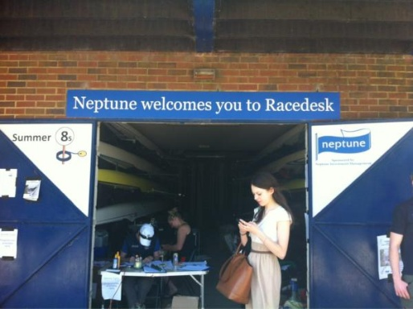
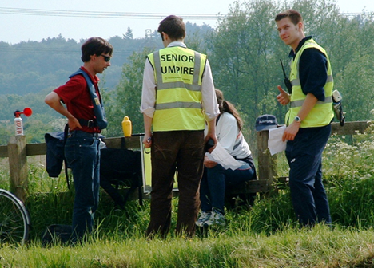
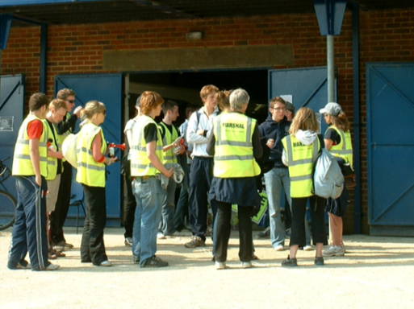
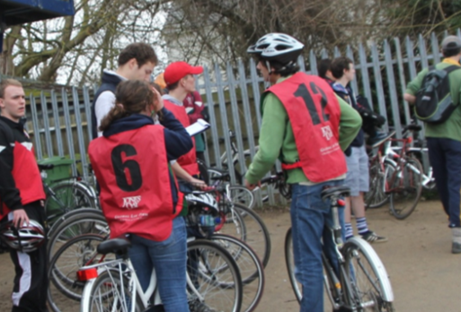
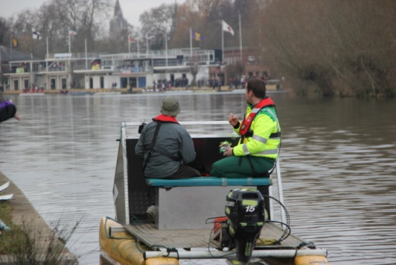
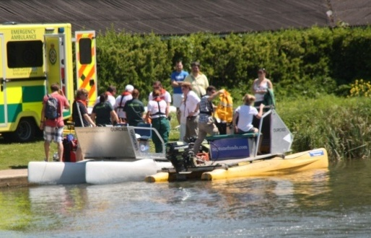
Introduction to Bumps racing Who’s who?
Racedesk
At Longbridges; the central base for the OURCs committee
Senior Umpires
They start the race
Marshals (yellow bibs)
Liaise with racedesk and the SUs to help ensure racing runs smoothly
Umpires (red bibs)
Cycle along and report on the verdict of the race (don’t have radios)
Launch Drivers
Follow races and transport First Aid
First Aid
Provide First Aid in case of emergency

Slide 6
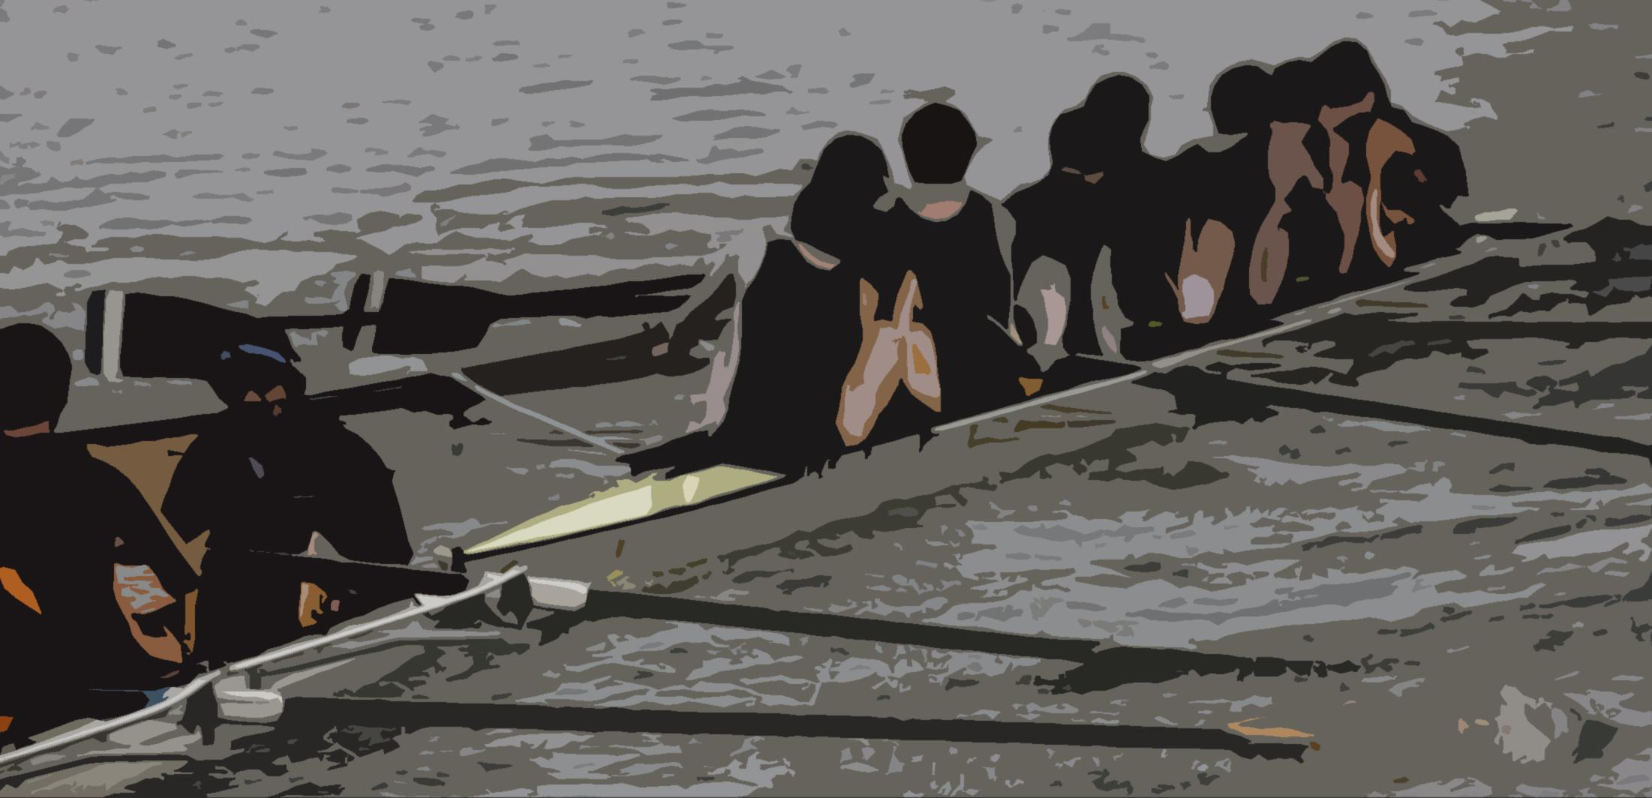
Information for BOTH marshals and umpires
Preparation
The circulation pattern

Slide 7
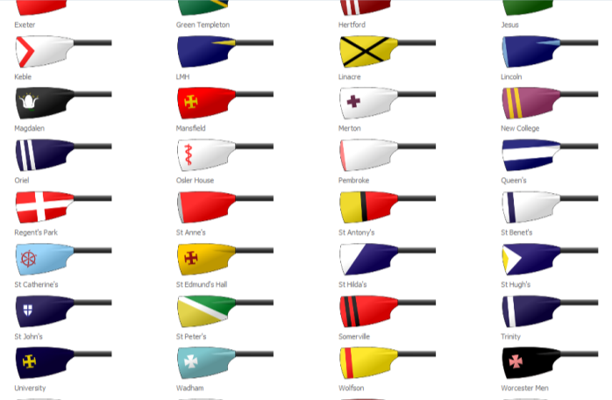
How to prepare for Bumps racing What you should do before your slot
Wear appropriate clothing – you will be outside for 2+ hours, hopefully on a sunny day, but this is unlikely in Torpids! Just a pair of leggings is not enough.
Set your watches to GMT – available online, regularly over the tannoy or at racedesk
Learn the circulation pattern off by heart
Try to learn some of the blade colours (although we do provide guides)
Find out where Racedesk is – it’s at Longbridges
If you’re umpiring, bring a bike that you can cycle fast, and has working brakes. You must wear a helmet
You must not drink alcohol, nor be drunk, on duty. Especially on Saturday.
Resources
Blade colours
http://www.ourcs.co.uk/information/blades

Slide 8
The circulation pattern on Race Day It’s different from when you’re training
Before the race
Crews 1–6 warm up above the gut in reverse circulation
Crews 8–13 warm up below the gut under normal circulation
Crew 7 can choose, but must stick to one or the other
Nobody should row in the centre of the river
During the race
During racing, crews race upstream may take any line. However they are advised to stick to the racing line as leaving it leaves them more liable to be penalised.
Crews that bump stop racing and tuck in to the sides of the bank
After the race
Once the following launch has passed, crews revert to ‘warm-up’ circulation in order to land

Slide 9
How to keep the SUs happy Upstream and Downstream
Donnington Bridge
Top bunglines
Bottom bunglines
Boat-houses A
Boat-houses B
Bottom Gut
Head
Finish
Univ
Greenbanks
Long-bridges
Middle Gut
Top Gut
Up to the head
Down to the bunglines
Upstream
Downstream

Slide 10
Marshal placement on Race Day Click the green button for circulation patterns!
Donnington Bridge
Top bunglines
Bottom bunglines
Boat-houses A
Boat-houses B
Bottom Gut
Head
Finish
Univ
Greenbanks
Long-bridges
Middle Gut
Top Gut
A boat on bunglines 1–7
A boat on bunglines 8–14
BH Island
Univ raft
Longbridges
BH Island
Univ raft
Longbridges
Skip >

Slide 11
The circulation pattern on Race Day Live demonstration (click the green buttons!)
WARMING UP
HEAD FOR START
WAITING
RACE STARTED
LANDING
< Marshals
A boat on bunglines 1–7
A boat on bunglines 8–14
BH Island
Univ raft
Longbridges
BH Island
Univ raft
Longbridges
Skip >

Slide 12
The circulation pattern on Race Day Live demonstration (click the green buttons!)
WARMING UP
HEAD FOR START
WAITING
RACE STARTED
LANDING
< Marshals
A boat on bunglines 1–7
A boat on bunglines 8–14
BH Island
Univ raft
Longbridges
BH Island
Univ raft
Longbridges
Skip >

Slide 13
The circulation pattern on Race Day Live demonstration (click the green buttons!)
WARMING UP
HEAD FOR START
WAITING
RACE STARTED
LANDING
< Marshals
A boat on bunglines 1–7
A boat on bunglines 8–14
BH Island
Univ raft
Longbridges
BH Island
Univ raft
Longbridges
Skip >

Slide 14
The circulation pattern on Race Day Live demonstration (click the green buttons!)
WARMING UP
HEAD FOR START
WAITING
RACE STARTED
LANDING
< Marshals
A boat on bunglines 1–7
A boat on bunglines 8–14
BH Island
Univ raft
Longbridges
BH Island
Univ raft
Longbridges
Skip >

Slide 15
The circulation pattern on Race Day Live demonstration (click the green buttons!)
WARMING UP
HEAD FOR START
WAITING
RACE STARTED
LANDING
< Marshals
A boat on bunglines 1–7
A boat on bunglines 8–14
BH Island
Univ raft
Longbridges
BH Island
Univ raft
Longbridges
Skip >

Slide 16
The circulation pattern on Race Day Live demonstration (click the green buttons!)
WARMING UP
HEAD FOR START
WAITING
RACE STARTED
LANDING
< Marshals
A boat on bunglines 1–7
A boat on bunglines 8–14
BH Island
Univ raft
Longbridges
BH Island
Univ raft
Longbridges
Skip >

Slide 17
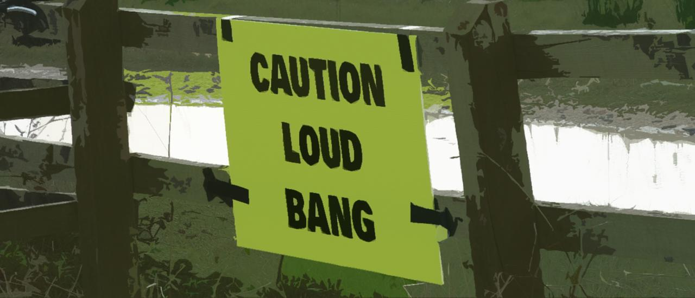
Information for marshals
River checks
The starting protocol
Klaxons, crashes and injuries

Slide 18
River checks How to take part in them
The order:
Head
Finish
Boathouses A
Boathouses B
Univ
Greenbank
Longbridges
Top Gut
Middle Gut
Bottom Gut
Donnington Bridge
Top Bunglines
Bottom Bunglines
Several times each division, the SU will ask for a river check.
One by one, each marshal should report over the radio if the river is clear
If the sequence breaks (no reply within 10 seconds), the next marshal should pick it up
These checks are vital because we cannot start races with other boats on the course!
What type of things do we need to know about?

Slide 19
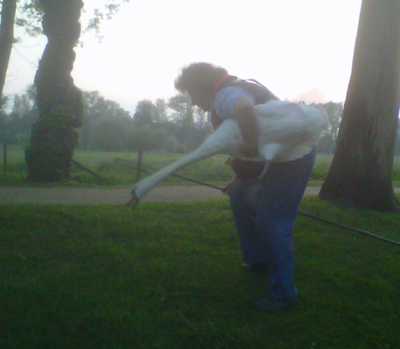
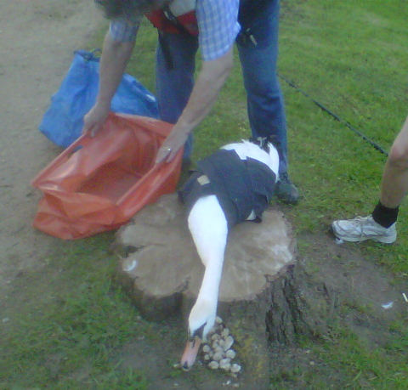
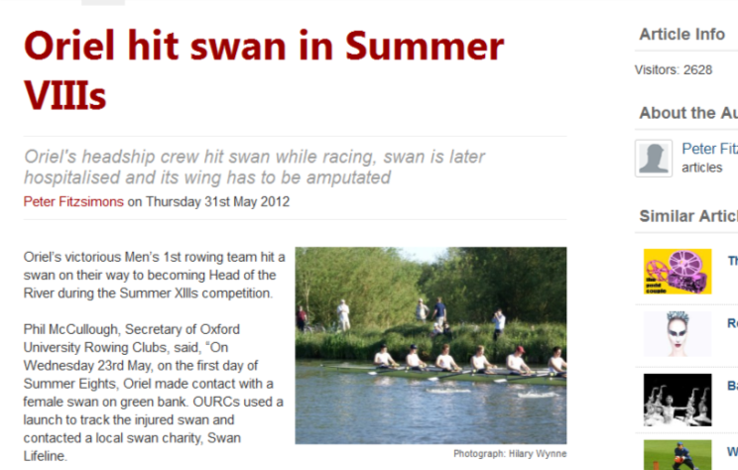
Do we really have to klaxon for swans? A story about animal welfare
During Summer Eights 2012, a boat narrowly clipped the wings of a swan that was hiding along Greenbank. OURCs spent two hours chasing an injured and distressed swan up the Cherwell cut. Its wing was later amputated. OURCs donated £50 to the swan charity for its assistance. Oriel were not fined for the accident as it was not their fault.
The story attracted a large amount of negative press from the community and the media (the article below attracting over 2600 views)
Harming a swan is a criminal offence which can be prosecuted – as much as we don’t want klaxons, we really don’t want criminal proceedings brought against crews.

Slide 20
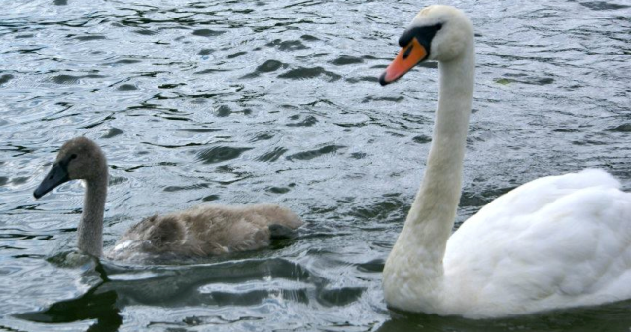
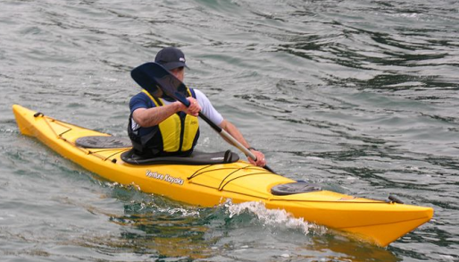
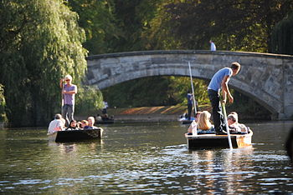
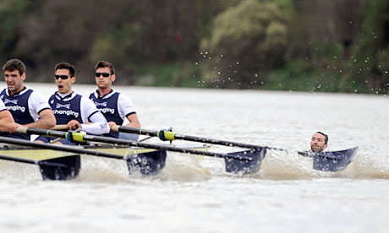
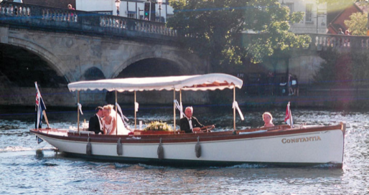
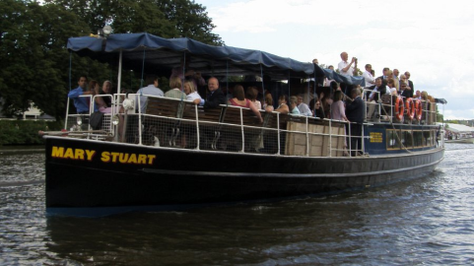
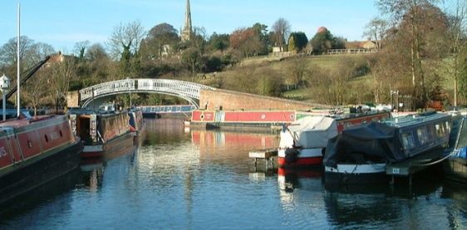
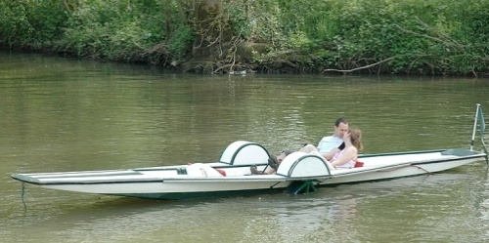
River checks Things we need to know about during a river check
Kayakers
They often suddenly emerge – keep sharp!
Photo: Wikipedia/Thruston
Swans
We need to protect them
Photo: Hilary Wynne
Punts
Slow but wildly unpredictable
Photo: Wikipedia/Evans1551
Swimmers
Yes – really.
Photo: guardian.co.uk
Other boats, such as:
The Constantia
The “Salters Steamers”
House boats
Source: Wikipedia/Mark.Murphy
Pedalos
Source: Wikipedia/Thruston

Slide 21
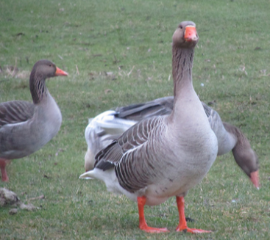
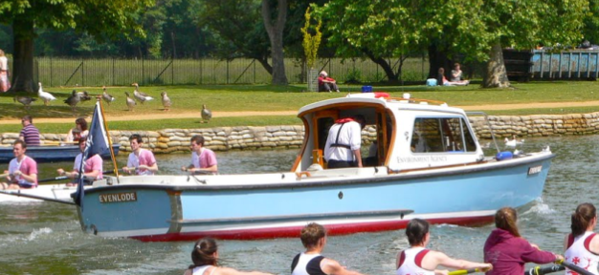
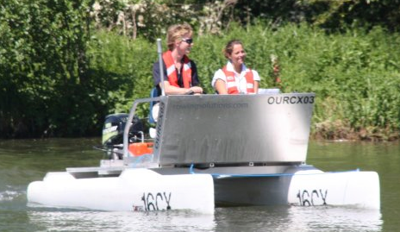
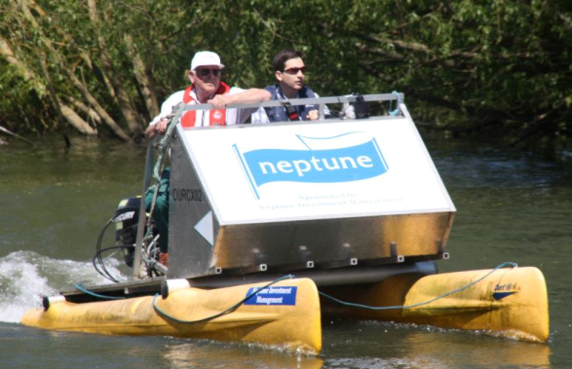
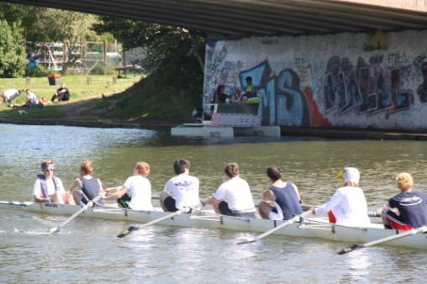
River checks Things we don’t need to know about during a river check
Environment Agency
They help us run Torpids
Photo: blogspot/oxford dailyphoto
Geese
Not a protected species!
note shorter necks..
Photo: flickr/slightlymore
Yellow (extra) launch
Normally stationed at Boathouse Island or Longbridges; has a radio
White (following) launches
Follows races; has a radio
Our crews
(Unless they’re in trouble or late)

Slide 22
River checks A live example
If the river is clear, say “Head, clear” “Finish, clear”, etc.
If not, please report it to the SU.
E.g. “Boathouses A, the narrowboat ‘X-ample’ is moving downstream along boathouse island.”
Now listen to the following clips of a river check. The wind may be strong, and people might be talking nearby – but you need to listen up for when it’s you!
“Model” check | Dealing with no response | “Live” example
The ‘no response’ example above has two marshals that do not answer: Boathouse B and Donny Bridge. It is preferred that the next marshal in line answers after 10 seconds (as Donny Bridge does), and not for the SU to prod the person (Boathouse B in the example).
Next slide >

Slide 23
Crew checks and pushing off You must check the boats and encourage them when to push off
Raft marshals should ensure that crews do not put their shell on the water until the previous division of their gender has landed (i.e. for Men’s Div. 1, Men’s Div. 2 must have landed before Men’s Div. 1 puts their shell on the water)
Crews must not push off until the following launch for the division immediately before theirs goes past. Then they are safe to push off and warm up
Make sure crews push off promptly to avoid delays
Men’s Division 4 lands
Men’s Division 3 puts boats on pontoon
Men’s Division 3 pushes off
Women’s Division 4 lands
Women’s Division 3 puts boats on pontoon
Women’s Division 4 races past
Men’s Division 3 races past

Slide 24
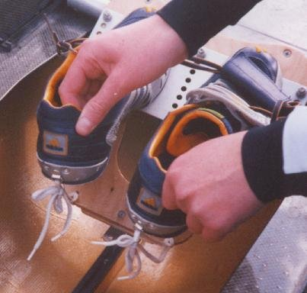
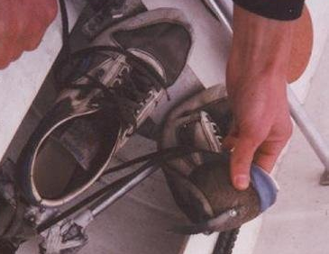
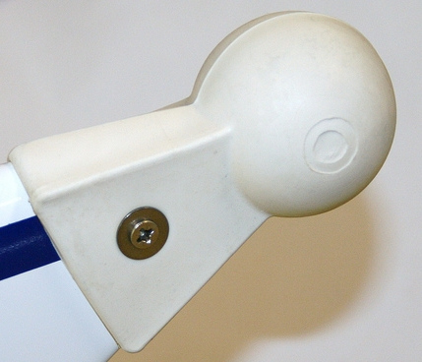
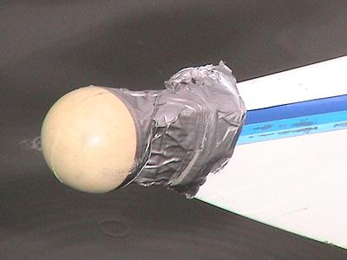
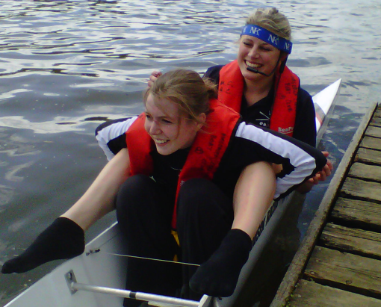
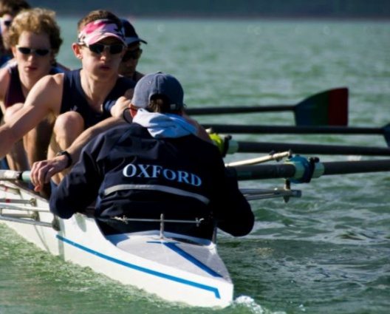
Crew checks and pushing off You must check the boats carefully
Before a boat sets off, you must check:
Heel restraints – forcefully lift up- they should not go above horizontal nor break
Footplate properly attached to boat
Bow ball firmly fixed – give it a wiggle
Lifejacket over cox’s outermost layer
Hatch covers are present and screwed tightly shut.
The boat has backstays and they are firmly attached.
Lights are attached to the boat for divisions requiring them.
Images 1,2, 4: packer.dsl.pipex.com/rowing
Image 3: Janousek website

Slide 25
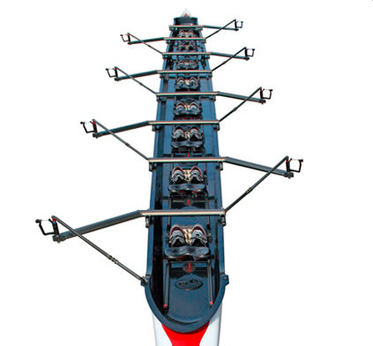
Crew checks and pushing off You must check the boats carefully
Before a boat sets off, you must check:
Heel restraints – gently lift up, they should not go above horizontal
Bow ball firmly fixed – give it a tug
Lifejacket over cox’s outermost layer
The boat has backstays and they are firmly attached.
Hatch covers are present (if meant to be) and screwed tightly shut.
Lights are attached to the boat for divisions requiring them.
The cox possesses photo ID for the whole crew.
Images 1,2, 4: packer.dsl.pipex.com/rowing
Image 3: Janousek website

Slide 26
Radios How to use them and how to look after them
To talk, wait for a break in radio traffic, push the large button on the side, wait one second, then identify yourself and whom you are trying to call. Keep the button pushed until one second after you finish speaking. Speak slowly and clearly. E.g. “Univ to racedesk…” or “Top gut to senior umpire…”
Listen out if racedesk or the SU are calling you.
If the battery runs out, find a nearby marshal to contact racedesk or phone racedesk.
Keep the radio dry and prevent it from falling into the river.
Don’t speak when someone else is speaking, or everyone will hear this sound:
Don’t put your radio or klaxon down – people do steal them and use them to delay racing!
Eights 2010, Men’s Division 1 after the 1MG: “SU, SU, there is an otter in the river!”
Next slide >

Slide 27
Radios What do they look like and how to use them
Don’t rotate this unless asked to by racedesk or the SU. It changes the channel and you won’t be able to hear what’s going on.
Push this button to talk!
Rotate this to increase or decrease the volume. Set it at a volume you can hear above the noise of the crowds.
Don’t push these if you want to talk– they don’t work.
Talk into here. This is the microphone and speaker all together.

Slide 28
Starting protocol We use the guns, the radio and the tannoy – listen out for them
With about 10 minutes to go, all crews should be below gut (5 minutes is sufficient for Div. 1 crews)
Expect a river check at this point
Alert the SU if you think someone will be late. Don’t be afraid to tell them to get moving!
With the 5 minute gun, all crews should be near their bunglines. All of them should be attached by the 1MG
Expect one final river check before the 1MG. It is vital that you report anything that might compromise the race
The 1MG fires, and then the race will start with the start gun 60 seconds later
Racedesk acknowledges all guns
Radio silence after 1MG unless there is a reason to stop the race

Slide 29
Starting protocol We use the guns, the radio and the tannoy – listen out for them
 | 5 Minute Gun | Waiting… | 1 Minute Gun | Waiting…. | Go!
Guns | BOOM! |  | BOOM! |  | BOOM!
Radio system | Racedesk acknowledges | River check
Tannoy | The 5MG has been fired! |  | The 1MG has been fired!
Next slide >

Slide 30
During the race If you can, give us good commentary!
You should have your hand on your klaxon, but off the trigger – think of it like a gun.
You need to be able to respond in an emergency, but not in danger of setting it off accidentally.
Remember – your priority should be safety. But if everything is OK, commentate!
We rely on marshals to give useful commentary that we relay over the tannoy:
“Trinity down to a length off Jesus”
“Corpus have bumped Merton”
“Oriel have crabbed”
“The Wolfson cox has conceded to Mansfield”
As soon as you have finished talking, let go of the radio button!

Slide 31
Additional duties Some marshals have extra roles
These duties will be reiterated during the briefing at racedesk:
Head- Instructs crews who have finished racing on when and where to spin to prevent a buildup by the finish.
Finish- Operates the finish clacker when the stern of boat passes. Crews that have spun must stay upstream of the finish until the last racing crew finishes.
Raft Marshals (Boathouse A and B, Univ and Longbridges)- Perform boat checks on each boat, liaises with competitors.
Top Gut- keep a record of crews that have passed. Need to be alert due to large number of bumps that occur in the gut.
Bunglines- Helps spin crews onto their bungline; Keep records of which crews are attached.
Bike- Cycles ahead of a race and provides warning to spectators.

Slide 32
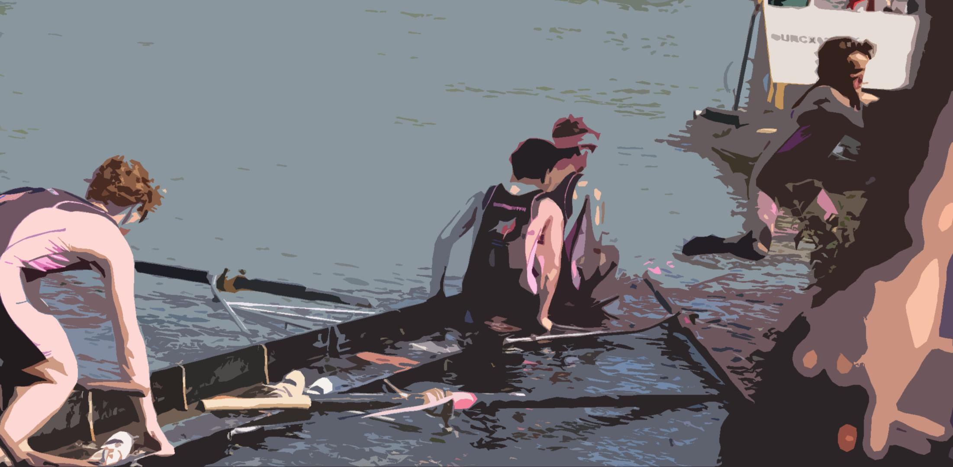
When things go wrong (useful for umpires as well!)

Slide 33
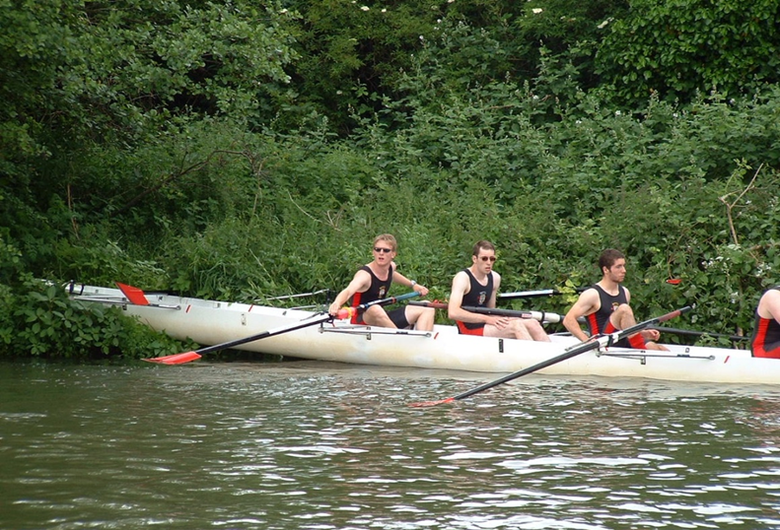
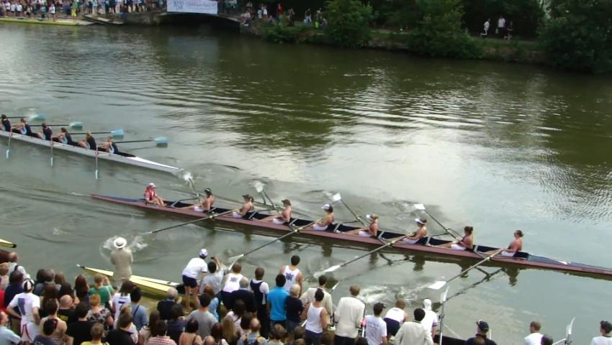
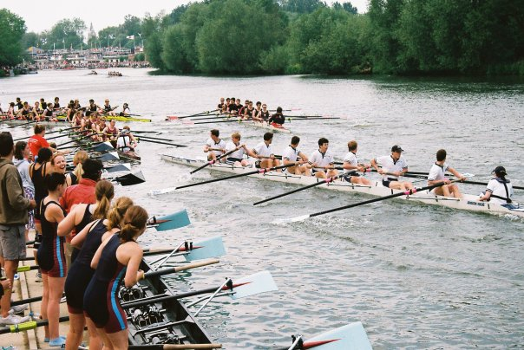
What can go wrong It’s important that everyone knows how to act
Equipment failures
Klaxons
Appeals
Crashes
Photo: Sarah Boddy

Slide 34
Equipment failures Find out the problem, then talk to the SU
A crew complains of an equipment failure – a broken rigger, a footplate loose, an oar snapped in half.
Do:
Ask them what their failure is, and ask them how long it’ll take to fix. Then, radio through to the SU with details. The SU will be able to advise.
Don’t:
Address this to racedesk
Radio through unless you know what the problem is. If the crew don’t know how long it’ll take to fix, the SU might be able to advise

Slide 35
Unexpected river traffic in the racing area Aborting the starting gun should be your priority
River traffic enters the course just before a division is due to start
If there’s 5 minutes to go:
Politely ask them if they could wait at one of the nearby mooring points until the division has passed them. Thank them for their cooperation if they do, and alert the SU to the traffic. If they don’t, escalate this issue to the SU immediately.
If the 1 minute gun has been fired:
Turn on your radio and immediately say “abort, abort”. The SU will postpone the start gun. Then explain what the problem is.
If the race is underway:
Ask them to move back to the place where they came from. Immediately inform the SU – we can delay a klaxon for as long as is reasonable, so at least some racing can take place.
Never be rude to river traffic. Check with the SU when they can move on, and thank them for their cooperation

Slide 36
Firing blanks If the start gun doesn’t fire, don’t worry
The start gun does not fire as expected
Protocol:
If the gun does not fire after 70 seconds from the 1MG, the SU will say “abort abort” or something similar over the radio and all crews should sit easy. Once this information is relayed, the next gun to be fired will be another 1 Minute Gun and the bungline marshals will be asked to tell nearby crews.
Race ends
Race begins!
Five Minute Gun
One Minute Gun
Klaxon….
Start aborted

Slide 37
Klaxoning races When and when not to do it
You must klaxon if, during a race:
Anyone falls in the water – be it spectator, rower or cox
First Aid is required at a scene on the water
A dangerous crash or situation is immediately imminent
The racing line is unavoidably blocked and there are racing crews imminent
You hear another klaxon
Please take the time to remember these scenarios in your head. Klaxons mean the cancellation of divisions and unhappy people, but they could also save someone’s life.
The decision to klaxon is YOURS, DON’T WAIT FOR AN INSTRUCTION TO KLAXON!
We’re now going to cover these points in more detail.
Next slide >

Slide 38
Klaxoning races When and when not to do it
You must klaxon if, during a race:
Anyone falls in the water – be it spectator, rower or cox
First Aid is required at a scene
A dangerous crash or situation is immediately imminent
The racing line is unavoidably blocked and there are racing crews imminent
Why? Boats are heavy, fast-moving objects. Blades could knock someone out. The river is especially cold and someone could become hypothermic.
Your job is to stop a boat from hitting a person on the water.
Sometimes it’s easy to spot. Sometimes it’s not. Watch these videos now:
Torpids 2011 – St Anne’s M1 Rammed by Pembroke M2
Summer Eights 2004 – Men’s Division 1 crash

Slide 39
Klaxoning races When and when not to do it
You must klaxon if, during a race:
Anyone falls in the water – be it spectator, rower or cox
First Aid is required at a scene on the water
A dangerous crash or situation is immediately imminent
The racing line is unavoidably blocked and there are racing crews imminent
For the safety of all competitors, if someone needs first aid, stop the race. All boats must stop in order that they do not impede the safety launch.
Signs to look out for:
Someone looking unconscious
Someone writhing around in pain, or a cox holding their back
A really serious collision
A whole crew trying to attract your attention
Point for discussion: would you klaxon this? Torpids 2010 – Wadham M3 on SEH M2

Slide 40
Klaxoning races When and when not to do it
You must klaxon if, during a race:
Anyone falls in the water – be it spectator, rower or cox
First Aid is required at a scene
A dangerous crash or situation is immediately imminent
The racing line is unavoidably blocked and there are racing crews imminent
We aim to try and stop serious collisions before they happen. A crew about to clip the bank doesn’t necessarily warrant a klaxon (unless they’re injured).
Think: is there a big difference in speed? Does a crew have no safe option?
Watch this (infamous) video now: Summer Eights 2009 – “Peter’s, NO!”

Slide 41
Klaxoning races When and when not to do it
You must klaxon if, during a race:
Anyone falls in the water – be it spectator, rower or cox
First Aid is required at a scene
A dangerous crash or situation is immediately imminent
The racing line is unavoidably blocked and there are racing crews imminent
The racing line is the entire river – crews can and should avoid other crews by any route possible.
Sometimes that’s not possible. If the entire width of the river is blocked and there are imminent crews, you must klaxon to stop the race.
This is possibly the hardest one to understand (and is also the most frequent), so we’re covering it in more detail.

Slide 42
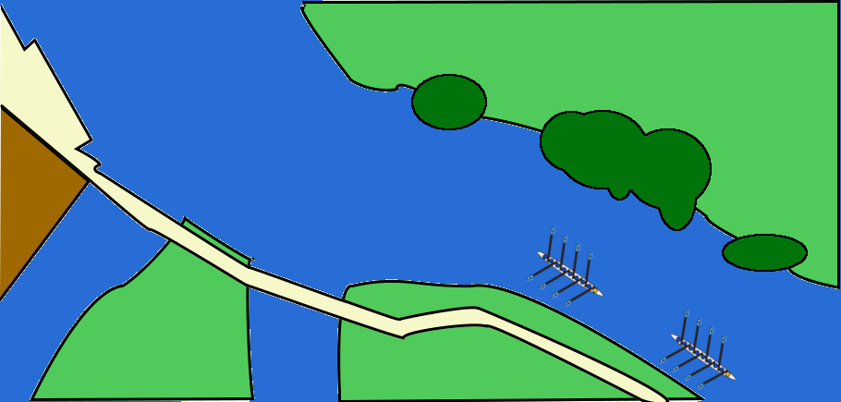
Quiz Do you know when to klaxon?
Crew B
Crew A is being chased by crew B as they exit the gut. Crew B is about a length behind crew A, and the crews have kept this distance for a while.
Crew A
Crew A’s stroke man manages to catch a horrific crab that noticeably slows them down, and sends them towards the towpath bank. The cox does not concede. The chasing crew, noticing this, take evasive action; they aim to overtake on the right hand side and go for the row past.

Slide 43
Quiz Do you know when to klaxon?
Sadly, they were too close behind, and the two crews become tangled. The two crews have bumped.
In Torpids, crew B is no longer part of the race. It is their duty to clear the racing line as soon as possible. Crew A must continue racing.
So let’s say that crew A have managed to wrestle free of their crab, but the glancing blow collision results in crew B getting a bit tangled up.
Do you klaxon?

Slide 44
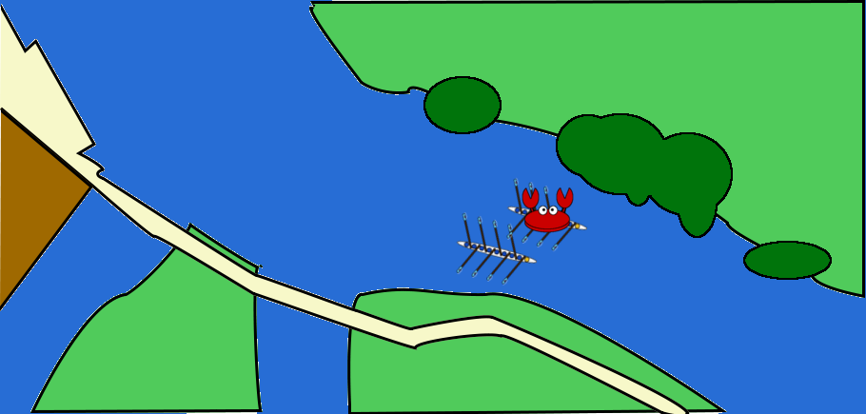
Quiz Do you know when to klaxon?
Answer: No
The racing line is blocked, but because there are no crews yet in sight, the race should NOT be klaxoned. Be on standby – klaxon in hand, ready to fire in case the situation changes.
Now that A is free, they should make every attempt to get back to racing speed. Let’s say that they do. In the case above, they’ve crossed over at Longbridges and continue racing. Crew B should tuck in to the bank by the trees.

Slide 45
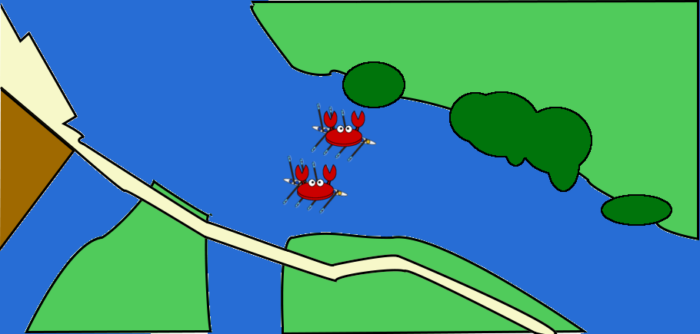
Quiz Do you know when to klaxon?
Let’s suppose crew A weren’t being coordinated and are not going anywhere fast. Both crews have crabbed and are now stationary. The racing line is blocked.
Do you klaxon?

Slide 46
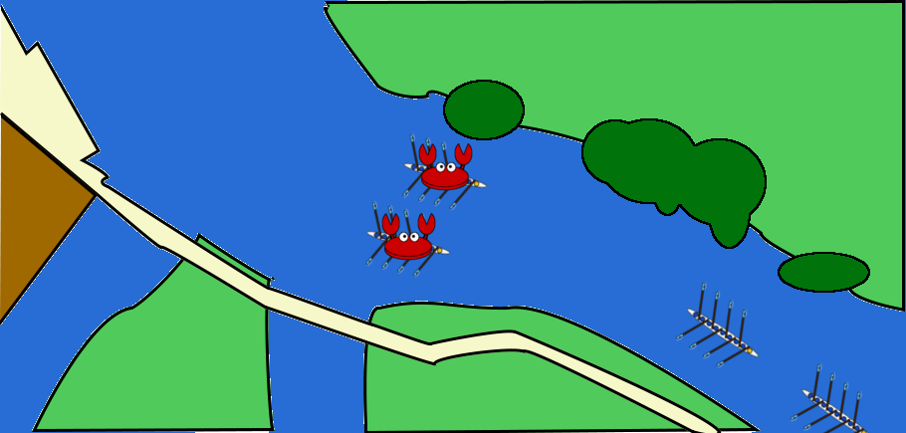
Quiz Do you know when to klaxon?
Answer: No. There are no imminent crews.
But: Both crews are still entangled and going nowhere. Both crews are at risk of jeopardising the race. You should be alert and paying attention, ready to klaxon if necessary.
Crew D
A few seconds later, it is apparent that these crews are not going anywhere fast, and two more crews are not far behind, in a closely contested battle.
Crew C
Do you klaxon?

Slide 47
Answer: Yes. Crew C must stop to avoid hitting A and B, but can’t stop because D will hit them.
Klaxon this race immediately. Press down for at least ten seconds, firing it directly at crews C and D.
Remember the guidelines!
You must klaxon if, during a race:
Anyone falls in the water – be it spectator, rower or cox
First Aid is required at a scene
A dangerous crash or situation is immediately imminent
The racing line is unavoidably blocked and there are racing crews imminent

Slide 48
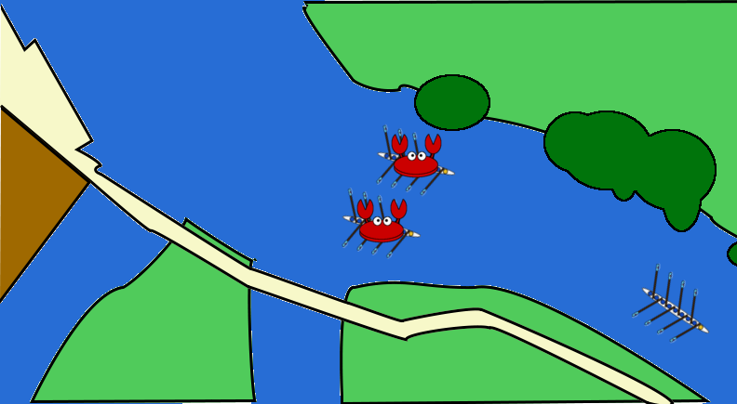
Quiz Do you know when to klaxon?
Let’s suppose that crew C is not being chased by anyone, as in the above picture.
Crew C
Do you klaxon?
Answer: Yes. Crew C still has nowhere to go. Although in this case, since C’s cox should have enough common sense to hold it hard in enough time, you may wish to delay the klaxon a second or two to see if the blockage dissipates.

Slide 49
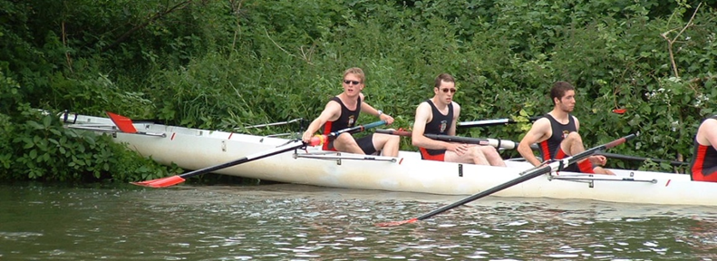
Klaxoning races If you are unsure….
If you’re uncertain as to what’s happening:
Avoid use of the word “klaxon” unless you are klaxoning the race yourself.
Ask ‘Is the race still live?’ or ‘Has racing stopped?’ or ‘What noise did I just hear?’.
Listen to the radio chatter, see if anyone else asks the same question
Just saying the word “klaxon” puts the division at risk, so be careful.
If there’s something wrong with your klaxon, wait until after a race has ended and refer to it as an ‘air horn’
Oh dear, Somerville. Nobody looks injured – but wait, where have bow, 2 and 3 gone?

Slide 50
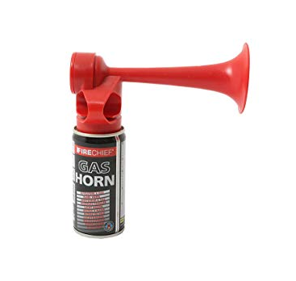
Klaxoning races Race protocol
Press with two fingers through these holes
To klaxon a race:
Fire your klaxon, by holding the button down for a count of 10 seconds, or until all crews in your vicinity have held it hard. Count them in your head, it’s longer than you think!
While doing this, grab your radio and turn it on so all marshals can hear your klaxon
The first thing you will be asked (and they will ask repeatedly): is First Aid required?
State your location and if First Aid is required. If in doubt, say “not sure” and we’ll dispatch them just in case.
Then state why you klaxoned.
If you hear a klaxon, live or over the radio:
Fire yours until all crews near you have stopped, at least 10 s and also through your radio as above
Maintain radio silence unless an immediate medical emergency happens near you
This is not a button – don’t try to press it!
Don’t hold – cryogenic effect!

Slide 51
Klaxoning races Race protocol
Press with two fingers through these holes
Once a klaxon has been fired:
All crews must hold it up hard and not move an inch (except to make way for First Aid) until the SU says it’s safe to
Crews must then immediately revert to warm-up circulation – that is, reverse above the gut, normal below it
The SU will say when it is safe for boats on the rafts to push off.
This is not a button – don’t try to press it!
Don’t hold – cryogenic effect!

Slide 52
Klaxoning races Some final thoughts
Often, people around you might shout “klaxon” at you. Often, they have no idea what is going on. Take a moment, and think:
Is anyone in danger?
Can I prevent an accident by klaxoning?
Does a racing crew have no safe action but to hold it up?
If the answer to any of these questions is yes, then klaxon. But if not, ignore them.
It can take courage for a novice marshal to fire their klaxon;
Everyone hates a race being abandoned due to unnecessary klaxons;
BUT the safety of the competitors is in your hands. Do what you think you have to for the sake of the rowers’ safety.
It is YOUR decision to klaxon, don’t wait for someone official to tell you, you ARE the official!

Slide 53
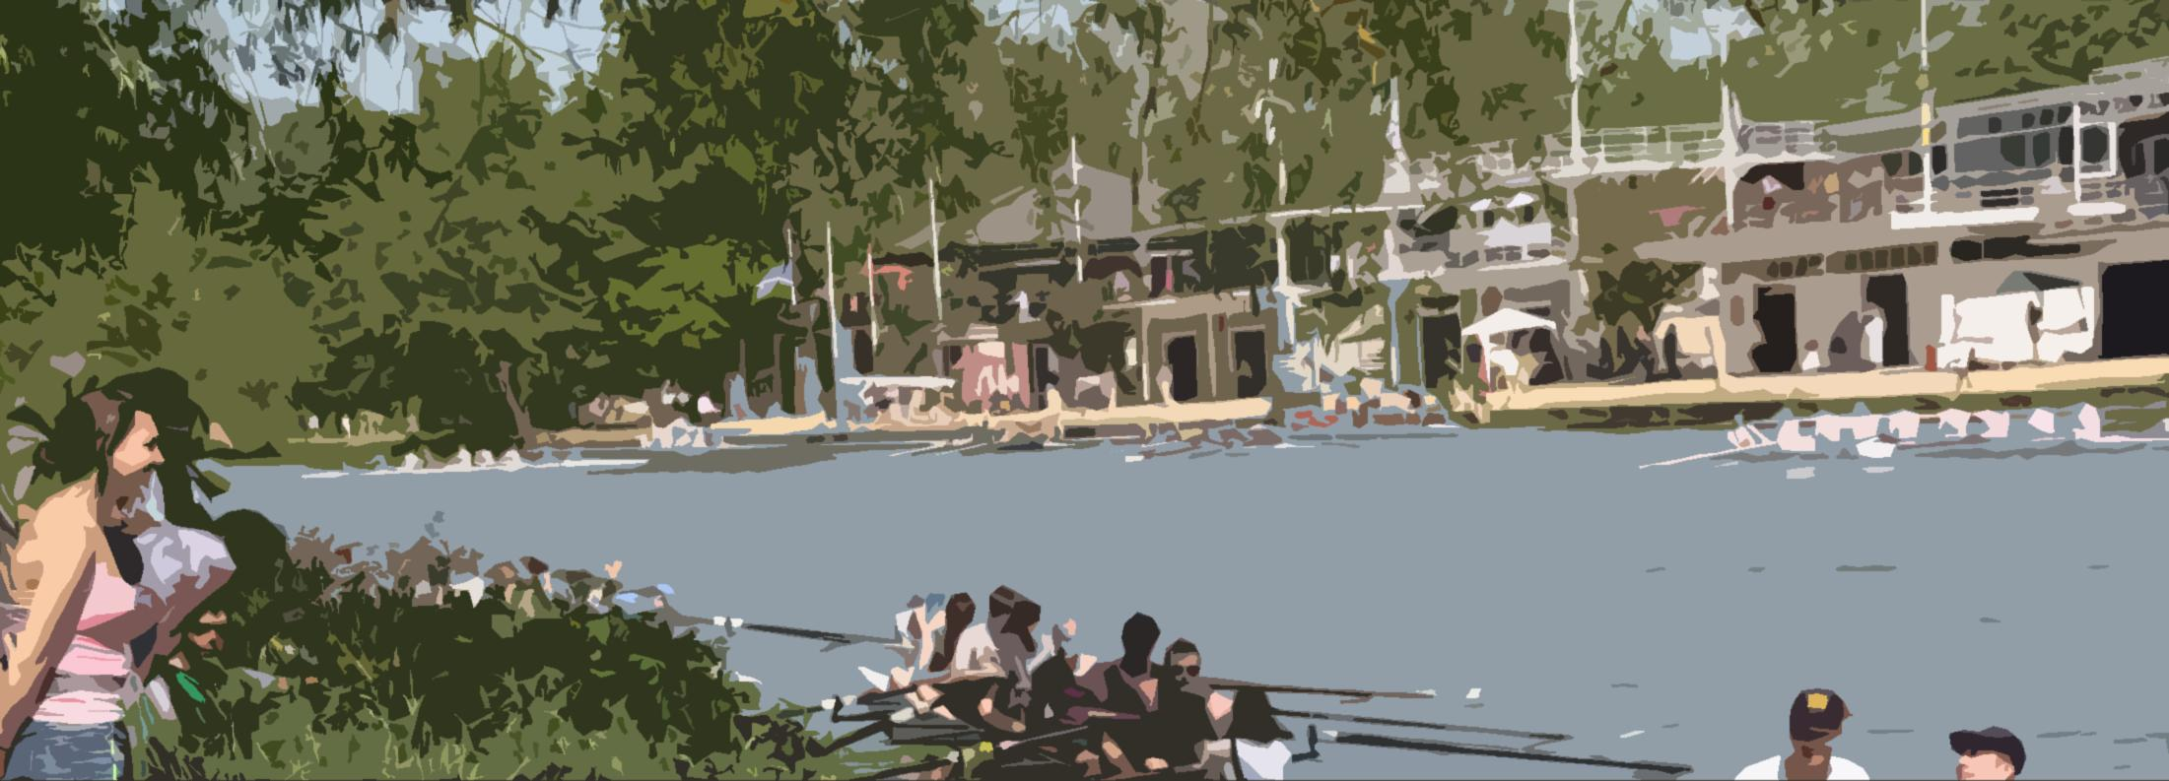
Information for towpath marshals
Look out for towpath users
Be polite! Don’t order people around
Marshalling and Umpiring: College Presentation
4

Slide 54
Do we really need towpath marshals?
YES!
As the students who were around when towpath marshals were introduced have now mostly graduated or are graduating, a reminder of why towpath marshals (and bankrider briefings) were introduced in 2016:
Torpids 2015: A bankrider knocks a member of the public into the water, causing damage to the member of the public’s possessions
Torpids 2016: A different bankrider hits a small child while trying to follow their crew
Both instances necessitated the involvement of the University insurers.
These are not the only “near misses” we have had in bumps over the last few years.
We know it is a pain providing towpath marshals, but it is significantly easier than banning bankriders and insisting on full-time static umpires (like Saturday of Eights) would be.

Slide 55
Towpath Marshals
Alert the general public as to what’s going on
4-5 standing, two cycling
Standing Marshals can be placed at:
Head of the River
Donny Bridge Upstream side
Donny Bridge Downstream side
Univ gate (small black gate just downriver of Univ boathouse)
Isis Farmhouse (the pub)
Listen to the radio but DON’T take part in river checks!
55

Slide 56
Standing marshals: jobs
Ask incoming pedestrians and cyclists to read the signs we will be putting up.
Talk to vulnerable groups – families with young children, people with poor balance or mobility – and make sure they understand what is happening
ADVISE them to stay to the sides of the towpath during races, but you cannot require them to move so be extremely polite
If people are standing in narrow sections, suggest better places to watch from (most of the narrow parts of the towpath are also not fantastic to watch from. the gut corner is good, there’s lots of space on the towpath and lots of carnage on the river!)
ADVISE cyclists going against the race direction to get off their bikes and stand clear when the race comes
Keep a special look-out for young children, who don’t look where they’re going
Listen to your radio so you know when races are happening
56

Slide 57
Standing marshals: before races
When you hear the 1-minute gun announced by the SU, start playing your recorded message on your megaphone every 20-30 seconds or as required until the last cyclist for the race has gone past you (do start this early at the Head too)
If at Donny Bridge point away from the bunglines – either upstream, or up the paths to the top of the bridge
If there’s a knot of people in the bunglines area, talk to them beforehand please
If delays occur or the start is aborted, explain to everyone what’s happening
57

Slide 58
Early Bike Marshal
Roughly when the 1-minute gun goes, start cycling upriver. Stop at every big knot of people spilling onto the towpath, and politely say that a race will be coming soon and could they stand to one side when it does
You cannot order them out of the way, they have right of way
You should get at least past Longbridges by the time the race catches you.
Don’t hurry – stop and speak to people in detail if needed.
Watch where you are going, or bad things will happen
Listen to your radio so you know when races are happening
You shouldn’t need to use your radio, but if you do GET OFF YOUR BICYCLE FIRST!
58

Slide 59
Race Bike Marshal
As the race begins, cycle IMMEDIATELY ahead of the first boat and its bankrider & umpire
Say politely to all pedestrians that the race is now coming, we would appreciate them standing clear
If they don’t move, STOP and shout at the bank rider and umpire behind you to stop and look
Do NOT knock anyone over, or there will be bother
Do NOT cycle way ahead of the crews
Listen to your radio so you know when races are happening
But GET OFF YOUR BIKE if you need to use it!
59

Slide 60
Don’t worry about the river
Ignore river checks, they aren’t for you, they’re for river (yellow-bibbed) marshals
There are two occasions on which you should alert the Senior Umpire: if a pedestrian requires first aid or if a pedestrian goes into the water.
Do NOT tell the SU if there is a towpath blockage: if that happens all cyclists including umpires/marshals/coaches must simply wait until it clears. We will NOT be stopping the racing for a towpath blockage.
60

Slide 61
Do worry about the bank!
Don’t stand in the way of the race bikes yourself!
Don’t ever put your radio down
You do not need a klaxon
If you see a new problem in the river alert the nearest marshal (all of you have one nearby) and they will deal with it
If someone falls off the bank during a race, alert the Senior Umpire straight away, unless a river marshal is already doing so.
61

Slide 62
Keep the public safe – general points
Don’t worry about the river – unless there is an emergency and you don’t think the river marshals have seen it
Advise towpath users as to what’s going on and what they can do to stay safe
Be polite! You are the public face of the event, we get complaints when people are rude
Listen to your radio so you know what’s going on. Don’t put your radio down!
No alcohol, however tempting it may be.
Don’t sit down, you need to be wandering around talking to people all the time.
If there are large groups of people milling around on the towpath, please politely remind them of what’s going on and ask them to keep the towpath clear
Make a note of where small children are and ask parents to keep a hand on them during races. Small children are our biggest worry-they are fragile and unpredictable
Don’t stand in the middle of the towpath yourself!
‹#›

Slide 63
Points for cyclists The towpath isn’t yours!
Pedestrians have right of way, don’t order them about.
Watch out for groups of pedestrians, there may be something behind them you can’t see!
Always ride so you can stop quickly if you need to. People may appear suddenly, particularly around Donny bridge and crowds
Make sure your bike is in good repair! Getting basic repairs done on your bike is inexpensive and worth it; if you have an accident because your bike is in bad repair, it’s probably you who hits the tarmac or falls in the river!
You are legally required to have both brakes fully functional
Do not put anyone, yourself or others, at risk.
If in doubt, STOP!
Don’t carry anything in your hands while following a race
‹#›

Slide 64
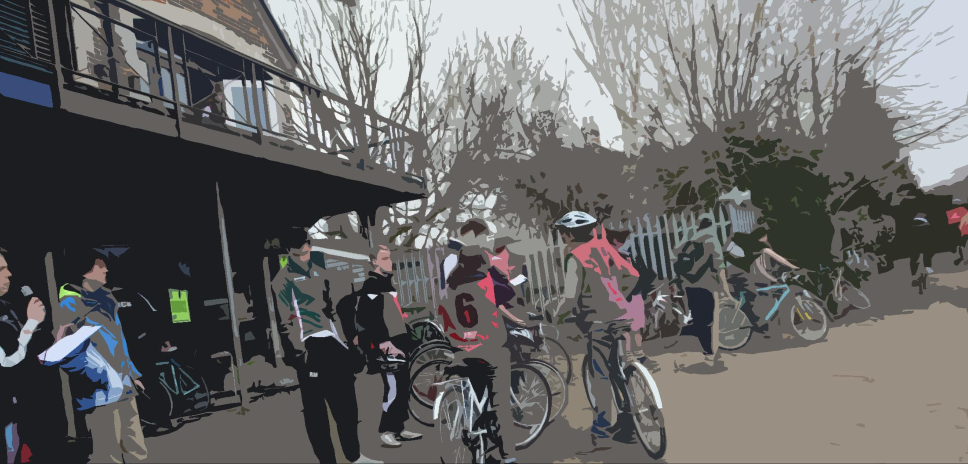
Information for umpires
What to look for
What to report back to us

Slide 65
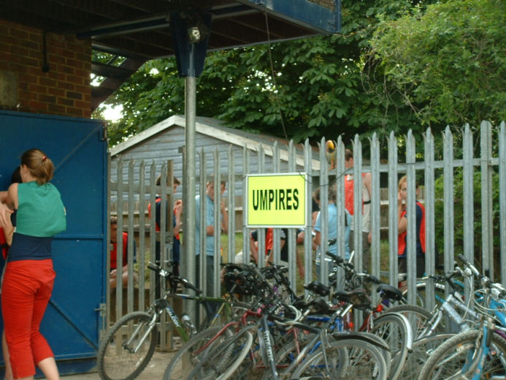
Umpires What you are expected to do
1
You get allocated a bungline and wear the corresponding bib
2
You cycle along with that crew, observing their race outcome
3
You come straight back to ‘Top Gut’ to report to OURCs
4
You head back to the bunglines, and the process repeats again

Slide 66
Allocation of a crew You must be impartial
1
You get allocated a bungline and wear the corresponding bib
You must not umpire for a crew if you’re from that college, or from the two adjacent colleges
You must not umpire for a crew if you are good friends, or related to any crew member in the above three crews
You must speak up if you have a reason to believe you would not be impartial
Men’s Division 2:
Exeter
New College
S.E.H
St Anne’s
Trinity
St Peter’s
Pembroke II
Someone from S.E.H must not umpire for crews 2, 3 or 4
Someone from S.E.H should ideally umpire crew ~10
Someone who is in a relationship with the Trinity cox must not umpire for crews 4, 5 or 6

Slide 67
Observing the outcome Safety first; then note as much as you can
2
You cycle along with that crew, observing their race outcome
You meet the crew at their bungline. Don’t engage in significant conversation with the coach or the crew – you must be impartial.
Umpires are the sole way by which we record bumps. It is therefore crucial that you pay attention
However, you should always make sure you look where you are going
Your primary concern must be your safety and that of others on the towpath. It’s your job, but observing the racing is secondary to this.
Never order a bystander out of the way
Follow the action: is a crew is about to bump, observe the bows. If it might be bumped, drop back to the stern. If both could happen, stay in the middle and watch both ends
Do not liaise with other umpires to find out about their results
Do not stop to talk to coaches after the race

Slide 68
Reporting back Be as detailed as you can be; we may need detailed information for appeals
3
You come straight back to ‘Top Gut’ to report to OURCs
Once the crew has bumped out, or crossed the finish line, return to tell us:
Was the cox holding the bungline on the start gun, and if not, were they in front of their start point?
Did they have more than one bankrider?
Any significant events, such as a crab, a big push on a crew, overlap, or a bump:
Where was it on the river? Both along and across are useful to know
What was the distance between the crews? How did it change?
Was there any overlap? Was the bump:
A concession from the cox? Did they concede with the correct hand?
By contact – if so, how did it happen?
A clean row-past – not just side-by-side, but the chasing stern clean past the bow of the bumped boat.
Did the cox of the bumped crew acknowledge the bump?
Did the bumping crew make all reasonable efforts not to obstruct following crews?

Slide 69
New Bumps Rules 2019 You need to understand these in general to help give good reports
NEW
Safety first, and the racing line is a real thing and matters
New Rule Zero – safety is of overriding importance in bumps.
It is likely you’ll be asked if your crew acted safely during the race. Dangerous crews may be penalised and you must report any unsafe behaviour.
Report any coxes you see wearing cameras or other equipment which restricts them from keeping a good lookout all around their boat.
If a crew collides with another (whether racing, bumped out or stationary on a raft) you’ll be asked how fast and steep the angle of collision was.
The Racing Line area is by the bank (except crossovers) and should be adhered to unless impossible.
By the towpath until the Gut, crossing at the upstream end of the Gut, by the trees on the first 2/3 of the Green Bank, crossing, and then by the towpath for the rest.
You may be asked if there were good reasons why a crew left the racing line.
Or if a crew’s actions sooner or later caused a dangerous incident (eg by them clearing into the racing line instead of out of it.)
Crews forced to clear into the racing line must then get out of it as soon as feasibly possible.
The rules about having to stop to avoid a collision, and have also changed. “Unavoidable external influences” are now different. You may be asked why boats have stopped without bumping.

Slide 70
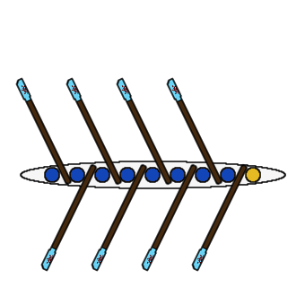
Distances between boats Learn these
Clear water – several lengths, enough for the water to settle somewhat
1, 2, 3, 4 (etc.) lengths – the number of boat lengths apart (below = 3 lengths)
¼, ½, ¾ lengths
A ‘canvas’ – less than ¼ length
Overlap – there is horizontal overlap between two boats,
but no physical contact.

Slide 71
Example reports If you can report to this level of detail, you’re doing great
The Green Templeton umpire:
“Green Templeton were down to ½ length on St Hilda’s as they exited the gut. Hilda’s cross early, but GTC stick to line. Side-by-side by the end of the Green Bank, and so when the GTC crew cross over, St Hilda’s realise a bump is inevitable and cox concedes. GTC then swerve to ChCh boat house to clear the racing line”
The St Hilda’s umpire:
“Hilda’s chased by GTC, who steadily gained on them during race. Hilda’s crossed early, GTC kept to racing line. GTC reached crossover, but Hilda’s left it a bit too late to concede, and with wrong hand. Thankfully GTC cox was competent and swerved out the way to avoid entanglement. Neither of them caused any problems or stayed in the racing line after the bump.”

Slide 72
Klaxons and three-boat-scenarios It gets a bit more difficult; just tell us what you saw and we’ll figure it out
Klaxons
Bumps gained before a klaxon count; bumps gained after do not. Listen out for a klaxon, and if you hear one, immediately look at your crew and check their status.
Three-boat scenario
Often, three boats are close together. This means you can’t cycle ahead/behind to where the action is, and so must keep an eye out.
If in doubt, try and cycle in a position to see the coxes of the two lead crews, so you can see the order of concessions
You are looking to ascertain the order of any bumps or concessions – if you can tell what came first, brilliant. If you knew it was 3 seconds between two concessions – excellent, we can piece together the story at race desk and record the correct outcome.
Any and all information – distances, times, relative speeds, locations, how close to the bank etc. – help in us working out what happened.
We appreciate this one is hard, just do your best.

Slide 73
Golden rules It gets a bit more difficult; just tell us what you saw and we’ll figure it out
Safety first – look where you are going!
If you didn’t see anything, that’s fine – tell us so.
Don’t make up anything you didn’t witness.
Don’t talk to coaches or other umpires about what you saw until the next day. Two unbiased, conflicting reports are often more helpful than one amalgamated story. Appeals can sometimes be resolved in the evening, and if we need to phone you up for more information, it’s important you stay impartial.
Come straight back to Top Gut to report after the race ends! Don’t faff around talking to coaches or filming sinkings (other people will be doing that, watch for it on YouTube later).
Look at a map of the river and learn where the different locations are.

Slide 74
Review of Objectives Do you now understand what needs to be done?
All people attending this briefing should know:
Know how bumps racing works
Know the circulation pattern before, during, and after racing
Know when and where to report for duty
Additionally:
Marshals only | Umpires only
4. Be able to identify river traffic | 4. Know how to follow a race
5. Understand how and when to klaxon | 5. How to report the outcome of a race
6. Understand how to summon First Aid
On the day, we will provide a 15 minute ‘refresher’ of the key duties, but this cannot cover all of this material so please learn it now!
And finally….

Slide 75
Rachel Quarrell’s Bumps Problems Copyright Dr Rachel Quarrell
“There are no guaranteed answers for some of these – they are intended to help […] marshals, officials and captains think through their role in the regatta, and anticipate problems and how to deal with them. Equally, some of these conundrums do have an answer – there are emergencies that have specific required ways they should be dealt with.”

Slide 76
Problem 1
You’re the Gut marshal with the five-minute gun about to be fired, and a crew comes scrambling towards you from the upper stretch of the river, saying that they’ve just snapped a seat and need to sort it out. What do you do? (several actions).
Click for answer >
Answer:
Ask them how long it will take to get a replacement
Talk to the SU immediately, relaying the information
Bonus points: Get Longbridges marshal to beg Catz/Hilda’s/Mansfield etc. for a spare seat – a changeover is simple.

Slide 77
Problem 2
You’re the boathouse or Univ raft marshal, and as the one-minute gun is about to be fired, you spot a schoolboy quad shoot out of the Cherwell Cut, and head down the Green Bank. What do you do – again what’s the most urgent action, and then what next? Once the rest of the marshals know, what can the bungline marshals expect to be asked to do and what is the race desk likely to have to announce?
Click for answer >
Answer:
Alert the SU to stop the 1MG and abort the start.
Then try and get their attention – if they can wait in the cut – tell them thanks, and let the SU know the 1MG can be fired.
Once the following launch has passed, let them move and thank them again.

Slide 78
Problem 3
You hear a klaxon further down the river from you, and a message over the radio confirming the division is being stopped. Since you are a marshal, you also have a klaxon. Do you use it?
Click for answer >
Answer:
Yes!!!

Slide 79
Useful links All the information you could need is just a click away
Home Page for Torpids 2023,
https://ourcs.co.uk/racing/torpids-2023/ - currently being populated
Racedesk Twitter feed – for live bumps and appeals
https://twitter.com/racedesk
OURCs Twitter Feed – for live commentary
https://twitter.com/ourcs
OURCs YouTube channel
http://www.youtube.com/ourcs
Rules of Racing
https://ourcs.co.uk/organisation/racing/

Slide 80
YouTube Corner Some ‘events’ to happen in recent Bumps history - some of these show good responses, others bad.
Links to YouTube videos – this is a wide range of what can happen!
Torpids 2012 – S.E.H. M2 crash
They were sinking so the race was stopped. The klaxons were badly done on this division
Torpids 2011 – Anne’s M2 on Wadham M3
Good concession from the Wadham cox
Torpids 2010 – Wadham M3 on SEH M2
Listen out for the first klaxon that happened on the first collision, but this was not picked up on! This is u
Torpids 2011 – St Anne’s M1 Rammed by Pembroke M2
The klaxon here was slightly too late to prevent the serious collision, but the marshal did well to fire it
Torpids 2015 - Regent's M1 ejector crab
Good steering around from Brasenose and Lincoln – however, this should have been klaxonned as soon as the rower enters the water.
Eights 2014 Men’s division VII
This is the result of an accidental klaxon – and why it is important for crews to keep a good lookout!

Slide 81
End
Feedback warmly welcomed: contact the committee via ourcs.co.uk
Marshalling and Umpiring presentation prepared by OURCs for the purposes of enabling Member Clubs to prepare its athletes for marshalling and umpiring duties.
Originally written by Phil McCullough; further contributions from Michael Pontikos, Bernard Tao , Tom Stewardson, Jonathan Williams, Tom Coles, Oliver Hedges and Sacha Tchen
Except where noted, content is property of Oxford University Rowing Clubs and may be freely shared for not-for-profit purposes provided a reference is made to the initial source.

Slide 82
Q&A
Your questions about appeals, penalty bumps, sandwich boats, marshal slots, whatever…

